Slide 1
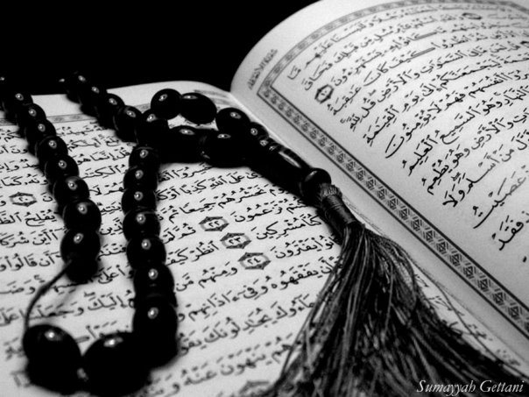
Qur`an Appreciation

Slide 2
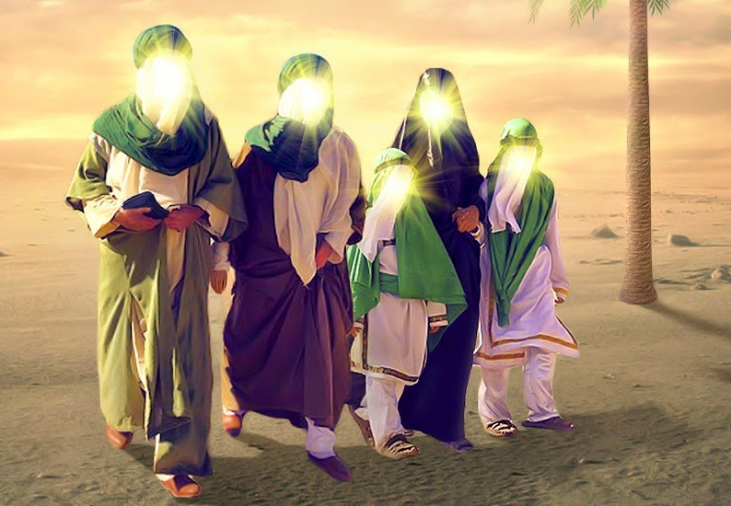
The Ahlul Bayt (as)
in the Holy Qur`an
QA

Slide 3
QA
Lesson 5
LO:
Why we go on ziyarah of the Ahlul-Bayt?
What do we do when we go on ziyarah?
Starter:
In pairs, list all the different cities our 14 masumeen are buried.
Notes:
Answer: Medina, Najaf, Samarrah, Kerbala, Mashad, Kazmain

Slide 4
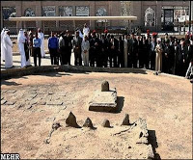
QA
Team Challenge
Where has the picture below been taken?
How many personalities can you list that are buried here?
Hint: It is somewhere in Medina
Notes:
Answer: Jannatul Baqi
Imam Hassan (A), Imam Zaynul Abideen (A), Imam Muhammad Baqir (A), Imam Jafar Sadiq (A), Fatima bint Asad, some sources say maybe Bibi Fatima (A)

Slide 5
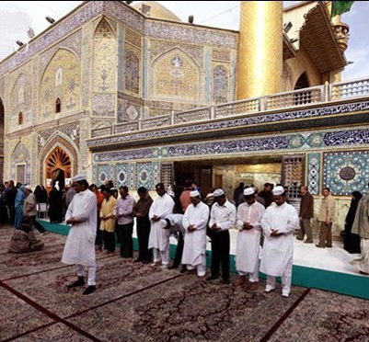
Why do we go for ziyarah of
the Ahlul Bayt?
QA
We aim to pay our respects to these special servants of Allāh (SWT)
Renew our pledges with them of being their sincere followers.
We reflect upon their lives, and try to implement these in our own lives back at home.
It gives us a much needed time out from our busy lives in order to build ours spirituality in the proximity of the holy personalities.
Notes:
Have students discuss in pairs or as a class before revealing the answers
As is described in the following verse, by undertaking this journey, we are fleeing to Allāh (SWT) and His Messenger (S):
وَمَن يَخْرُجْ مِن بَيْتِهِ مُهَاجِرًا إِلَى اللَّهِ وَرَسُولِهِ ثُمَّ يُدْرِكْهُ الْمَوْتُ فَقَدْ وَقَعَ أَجْرُهُ عَلَى اللهِ ۗ وَكَانَ اللَّهُ غَفُورًا رَّحِيمًا
[4:100] and whoever goes forth from his house fleeing to Allah and His Apostle, and then death overtakes him, his reward is indeed with Allah and Allah is Forgiving, Merciful.

Slide 6
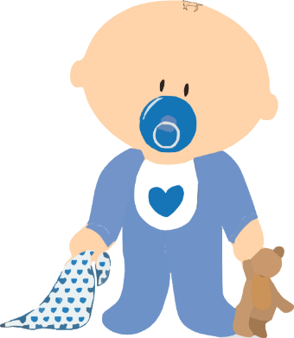
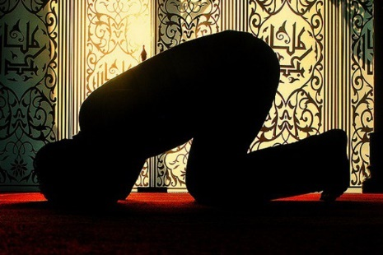
QA
The Story of Prophet Zakariyyah (a.s)
Prophet Zakariyyah (A) really wanted a child but he had reached old age and his wife was unable to have children.
When he saw the special favours Allah (swt) had given Bibi Maryam (A) at her prayer place, he used this special location in order to make his own prayer for a child.
His prayers were immediately answered:
Notes:
Emphasize the point: When we ask for our prayers from these holy places, they are accepted much faster.

Slide 7
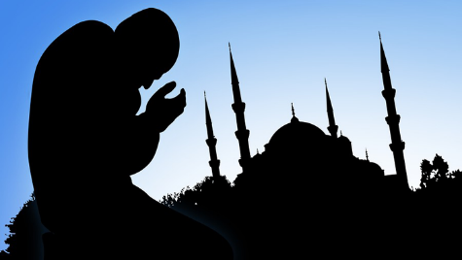
The answer to Prophet Zakariyyah’s (A) Prayers
QA
فَنَادَتْهُ الْمَلَائِكَةُ وَهُوَ قَائِمٌ يُصَلِّي فِي الْمِحْرَابِ أَنَّ اللَّهَ يُبَشِّرُكَ بِيَحْيَىٰ مُصَدِّقًا بِكَلِمَةٍ مِّنَ اللَّهِ وَسَيِّدًا وَحَصُورًا وَنَبِيًّا مِّنَ الصَّالِحِينَ
The angels called out to him, while stood praying in the sanctuary, "God gives you news of Yahya, confirming a Word from God. He will be noble and chaste, a prophet, one of the righteous."
What does the story of Prophet Zakiriyyah (A) teach us about praying in special places?
Notes:
Answer: Prayers answered faster
we are told that thousands of angels are continuously descending to these places and then ascending back to heaven

Slide 8
When we go for ziyarah of the Ahlul Bayt (A) we are required to seek permission to enter the signs by reciting idhn al-dukhul…
QA
O Allāh, I hold (as an article of faith) this honoured place of pilgrimage as sacred, in his invisibility just as I was certain and sure of his sanctity in his presence. I know that Your messenger and Your representatives (peace be upon them) are alive, receiving sustenance from You. They see my place of spiritual state, hear my words and answer my Salaam. Although You have shut off their speech from my hearing, but you have unlocked the door of my understanding because of my delightful recitation of their merits.
O Allāh, I hold (as an article of faith) this honoured place of pilgrimage as sacred, in his invisibility just as I was certain and sure of his sanctity in his presence. I know that Your messenger and Your representatives (peace be upon them) are alive, receiving sustenance from You. They see my place of spiritual state, hear my words and answer my Salaam. Although You have shut off their speech from my hearing, but you have unlocked the door of my understanding because of my delightful recitation of their merits.
Why do you think it is important to recite idhn al –dukhul before entering the Holy Shrines?
Notes:
Answer: Respect – just as we ask before turning up at someone’s doorstep

Slide 9
QA
On the day of Arafah, the Angels descend the shrine of Imam al-Husayn (a.s.) and listen to the prayers of the zuwwar before they go to the plain of Arafah to hear the prayers of the hujjaj.

Slide 10
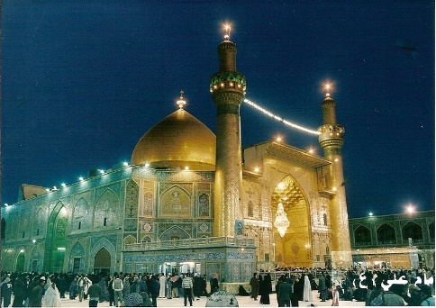
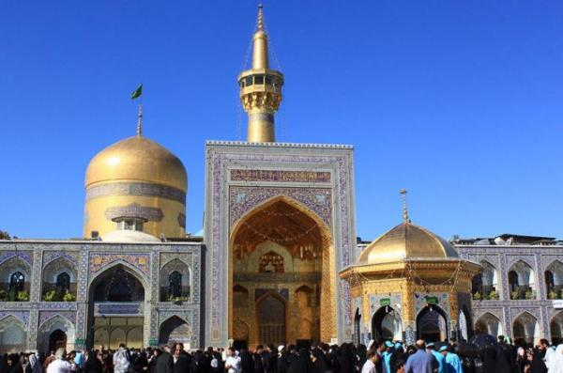
QA
Plenary
Partner Task:
In pairs, discuss your experience from your last journey for ziyarah. If you have not been discuss why you would go.
Be prepared to share your responses with the rest of the class.
Notes:
Select pairs at random to share their responses

Slide 11
QA
Notes:
Use the following quiz only if there is extra time. Split the class into two teams and go through as many questions as time permits.

Slide 12
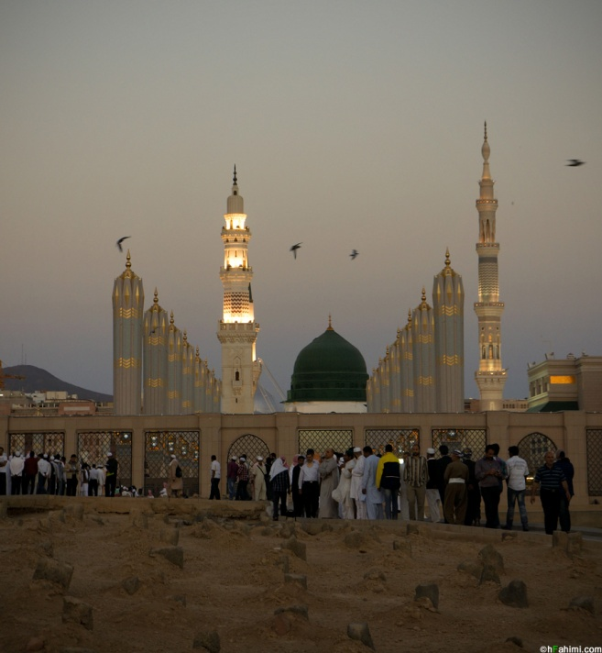
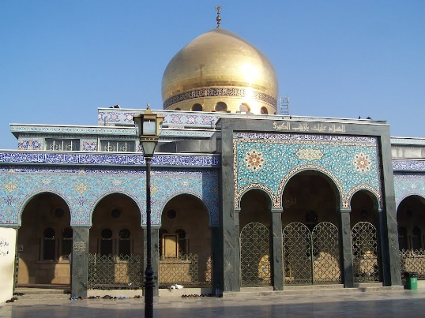
ACTIVITY: Guess the place and the name of all the holy personalities that are buried in each of the images below. There may be more than one personality associated with each imagine.
Holy Prophet (S)
Sayyida Zaynab (A)

Slide 13
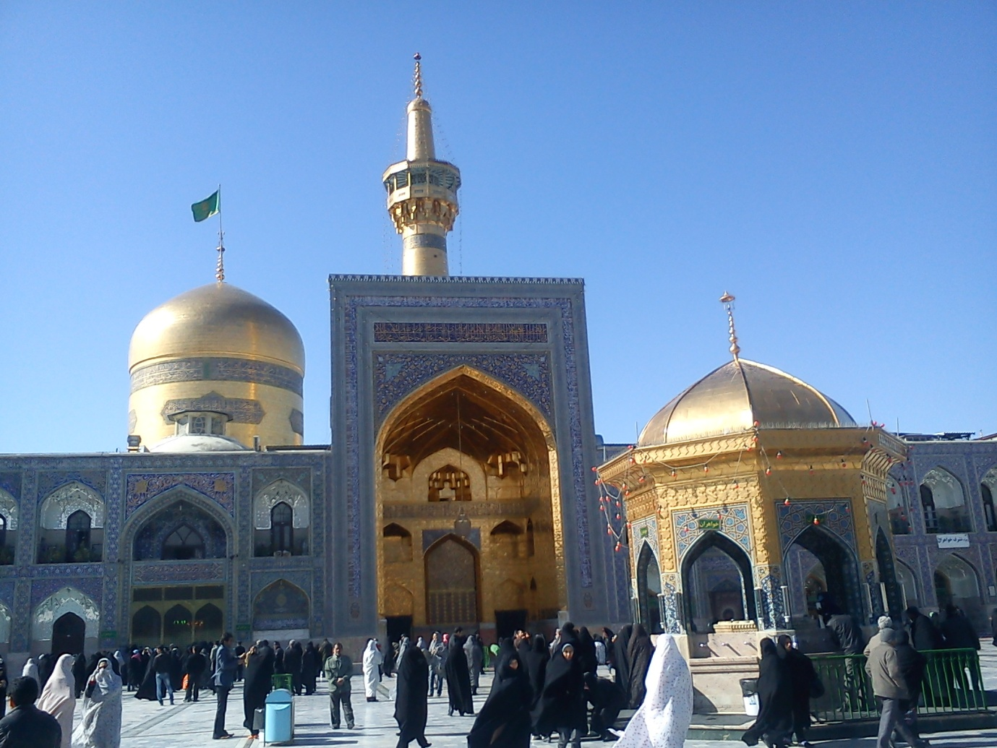
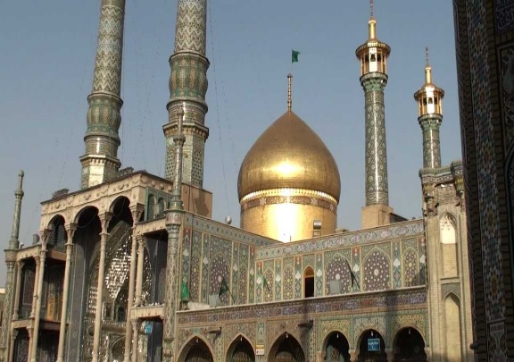
ACTIVITY: Guess the place and the name of all the holy personalities that are buried in each of the images below. There may be more than one personality associated with each imagine.
Imam al-Ridha (A)
Sayyida Ma’suma (A)

Slide 14
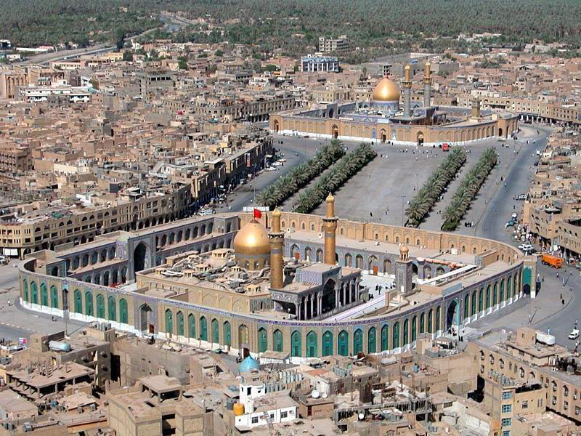
ACTIVITY: Guess the place and the name of all the holy personalities that are buried in each of the images below. There may be more than one personality associated with each imagine.
Hazrat Abbas & Imam al-Husayn (A)
Imam al-Hasan, Imam al-Sajjad,
Imam al-Baqir & Imam al-Sadiq (A)

Slide 15
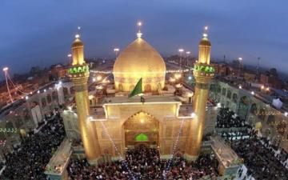
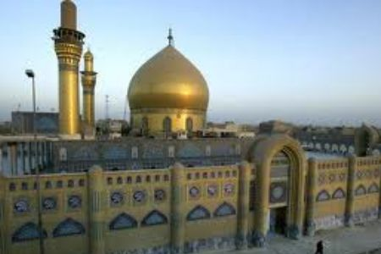
ACTIVITY: Guess the place and the name of all the holy personalities that are buried in each of the images below. There may be more than one personality associated with each imagine.
Imam al-Hadi
& Imam al-Askari (A)
Imam Ali (A)

Slide 16
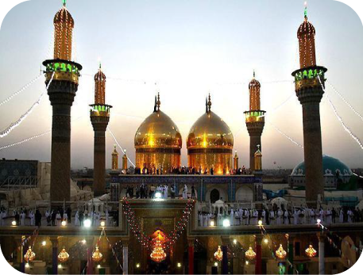
ACTIVITY: Guess the place and the name of all the holy personalities that are buried in each of the images below. There may be more than one personality associated with each imagine.
Imam al-Kadhim
& Imam al-Taqi (A)
Q: Where is Sayyida Fatima (A) buried?

