Slide 1
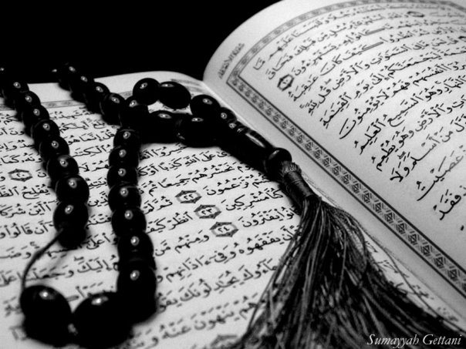
Qur`an Appreciation

Slide 2
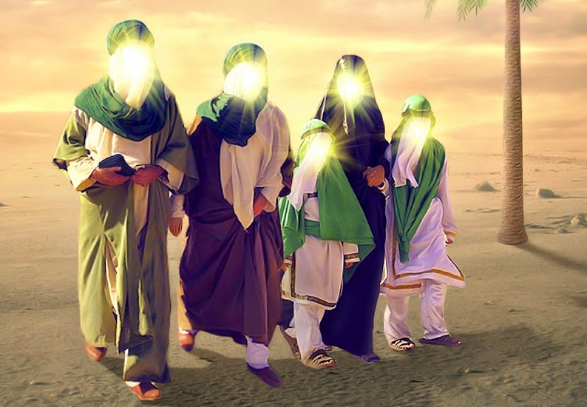
The Ahlul Bayt (as)
in the Holy Qur`an
QA

Slide 3
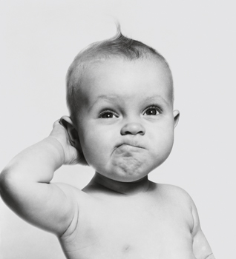
QA
Lesson 4
LO:
Verses of Wilayah
Starter:
Which surah in the Holy Quraan has two Bismillahs?
Which surah has no Bismillah?
Use your Quraans to find the surah number.
Notes:
Answer: Two Bismillahs – Surah Naml (surah 27)
No Bismillah – Surah Tawbah (surah 9)

Slide 4
QA
Verse of Wilayah Part 1
إِنَّمَا وَلِيُّكُمُ اللَّهُ وَرَسُولُهُ وَالَّذِينَ آمَنُوا الَّذِينَ يُقِيمُونَ الصَّلَاةَ وَيُؤْتُونَ الزَّكَاةَ وَهُمْ رَاكِعُونَ
[5:55] Only Allah is your Guardian and His Messenger and those who believe, those who keep up prayers and pay zakat while they bow
The term ‘wilaya’ mentioned in this verse does not mean friend and helper here, since friendship and helper refers to all Muslims, not those who give charity in while bowing down in prayer.
In this instance it means a sense of guardianship and leadership referring to the Mastership of Allah (swt), the Messenger (SAW) and Imam Ali (a.s.) as one.
Notes:
This verse [5:55] is one of the verses that, as a Qur’anic text, indicates to Mastership and Imamate of Ali ibne Abi Talib (A)

Slide 5
QA
Verse of Wilayah Part 1
إِنَّمَا وَلِيُّكُمُ اللَّهُ وَرَسُولُهُ وَالَّذِينَ آمَنُوا الَّذِينَ يُقِيمُونَ الصَّلَاةَ وَيُؤْتُونَ الزَّكَاةَ وَهُمْ رَاكِعُونَ
[5:55] Only Allah is your Guardian and His Messenger and those who believe, those who keep up prayers and pay zakat while they bow
The words prayer and zakat (charity) are usually next to each other in the Qur’an besides each other, but in this verse they are mixed together (giving zakat while in ruku).
Competition: In pairs, use your Qur’ans to find another ayat with both prayer and zakat. The pair who finds the ayat first wins. ☺
Notes:
This verse mentions the qualities and the characteristics of a particular person without mentioning his name, and it is up to the readers and audience to find out as to who fits in these qualities.

Slide 6
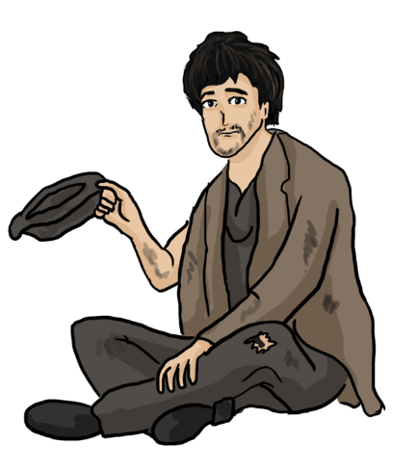
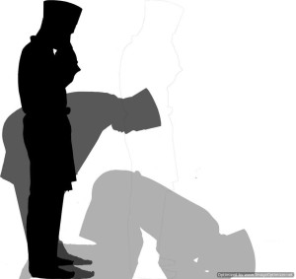
Background of Revelation
QA
A beggar entered the mosque (Masjidun Nabawi) and asked people for charity.
Nobody gave him anything.
Imam Ali (A) pointed his finger to him while he was bowing (ruku) in the prayer, gave his ring to that beggar.
After this verse was revealed, Ammar Yasir reports that the Holy Prophet (S) said:
The one upon whom I am Master, then this Ali is his Master.
When else has the Prophet said this?
Notes:
Answer: The Holy Prophet (S) also said the above statement in Ghadeer Khum in order to state the position of Imam Ali (A)
Imam Ali (A) himself repeatedly recited this verse for his own rightfulness.

Slide 7
QA
Verse of Wilayah
يَا أَيُّهَا الَّذِينَ آمَنُوا أَطِيعُوا اللَّهَ وَأَطِيعُوا الرَّسُولَ وَأُولِي الْأَمْرِ مِنْكُمْ ۖ فَإِنْ تَنَازَعْتُمْ فِي شَيْءٍ فَرُدُّوهُ إِلَى اللَّهِ وَالرَّسُولِ إِنْ كُنْتُمْ تُؤْمِنُونَ بِاللَّهِ وَالْيَوْمِ الْآخِرِ ۚ ذَٰلِكَ خَيْرٌ وَأَحْسَنُ تَأْوِيلًا
تَأْوِيلًا
[4:59] O you who believe! obey Allah and obey the Messenger and those in authority from among you; then if you quarrel about anything, refer it to Allah and the Messenger, if you believe in Allah and the last day; this is better and very good in the end.
Who those people in authority referred to in the ayat?

Slide 8
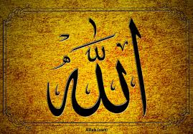
Verse of Wilayah
QA
This verse talks about leadership.
The first part of the verse commands those who believe to Obey Allah.
The second stage is: ....and obey the Messenger......Obey the Prophet (SAW)
And the third stage is: ......and those charged with authority among you.....Obey those who are from the Ummah

Slide 9
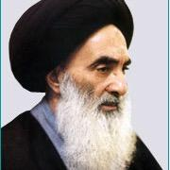
QA
[ أُولِي الْأَمْرِ ]
the phrase ulil-amr [ أُولِي الْأَمْرِ ] mentioned in this verse is the Imams (A)
We must obey them in all material, religious and spiritual matters.
Under some conditions the obedience of those who are appointed to a rank and charge a position, in society is necessary.
They are not themselves Ulil-amr but they are the agents of Ulil-amr eg Merja

Slide 10
Plenary
QA
Group Task:
One of your friends missed today’s lesson and has just whatsapped you asking what is the significance of the verses of Wilayah. How would you respond?

