Slide 1
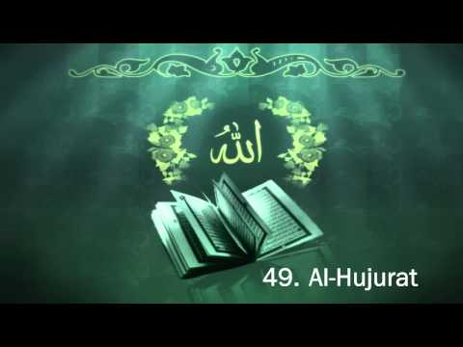
TAFSĪR SŪRAT AL-ḤUJURĀT
Class 7 - LESSON 1

Slide 2
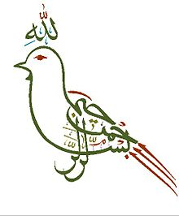
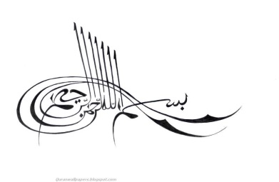
Starter Activity
Which Surah in the Holy Qur’an has two
And which one does not begin with

Slide 3
Can you guess the picture?
This chapter was revealed in Madina.
It has various names: Ḥujurāt (houses of the wives of the Prophet (s)) , Ādāb (Etiquettes) and Akhlāq (Morals)
Imam al-Ṣadiq (A) states: “Whoever recites Sūrat al-Ḥujurāt every night or day shall meet the Prophet (S) in his lifetime.”

Slide 4
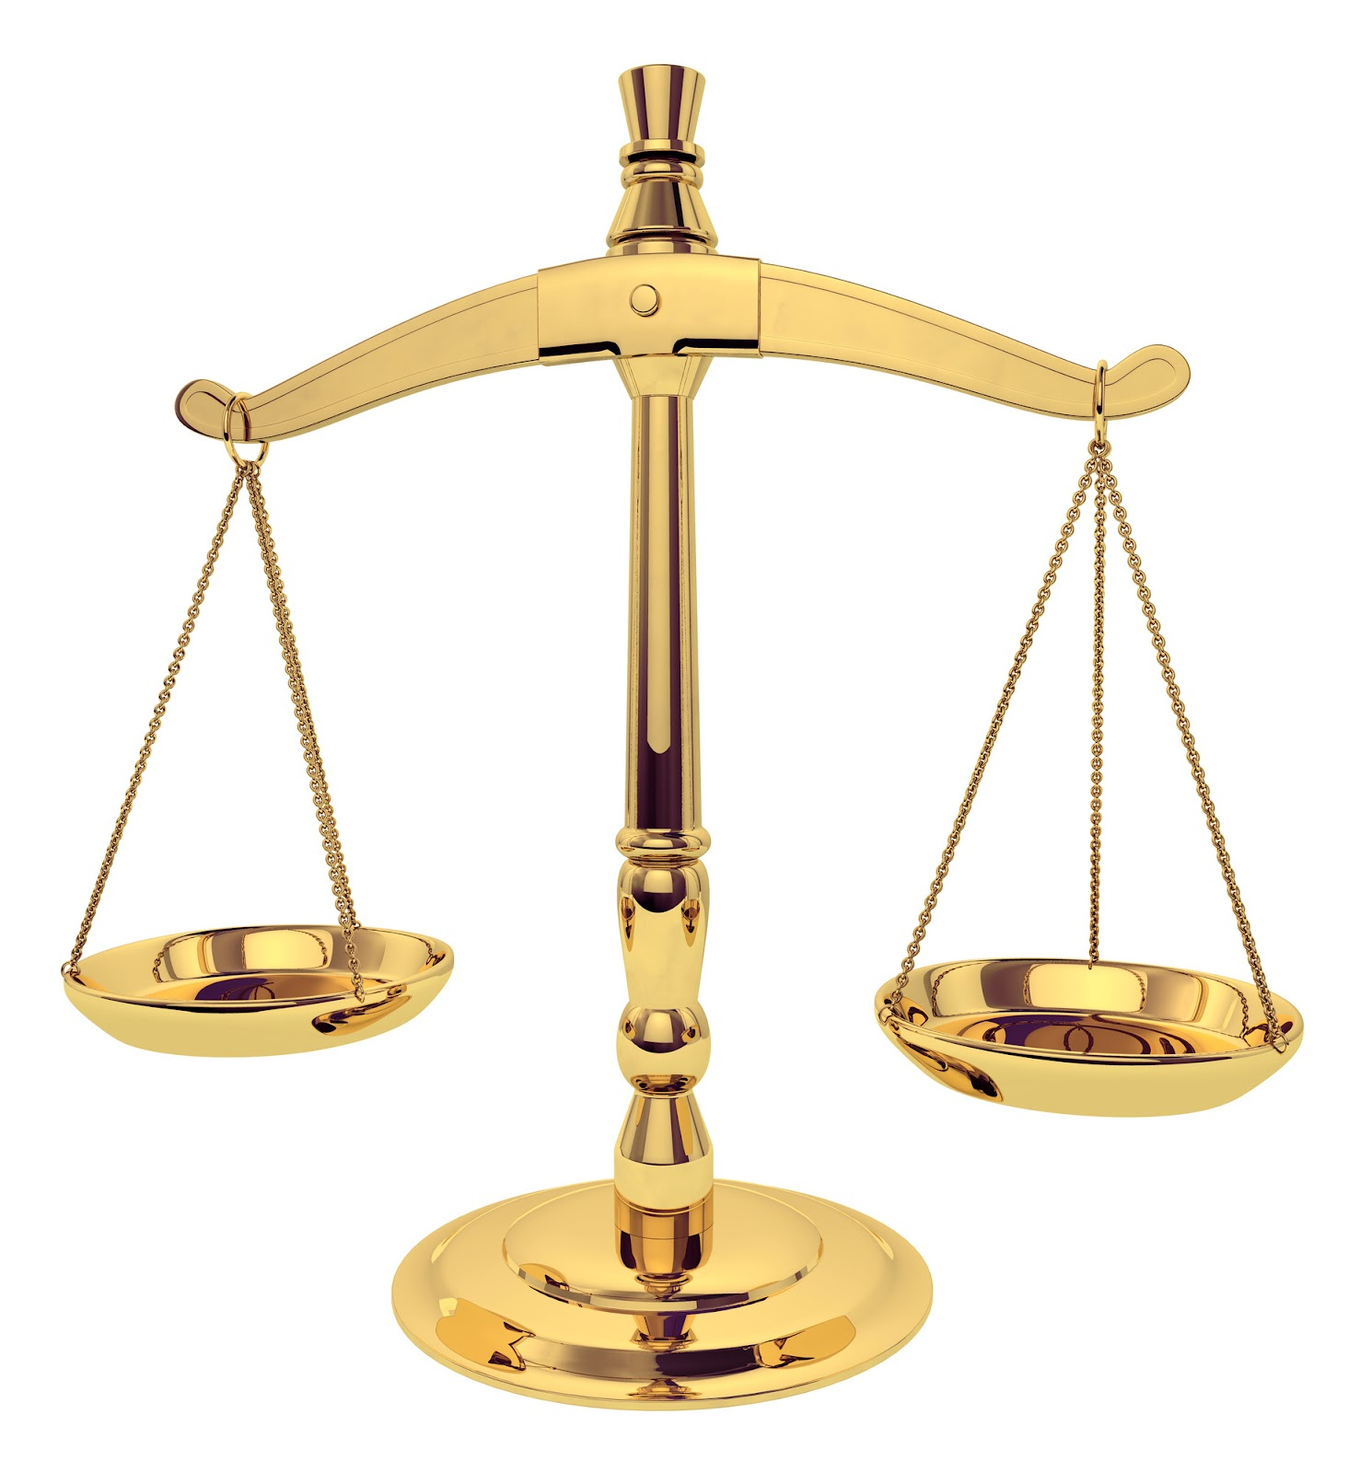
Some themes discussed in this chapter:
Not to make fun of people, name-calling, excessive suspicion, spying on others and backbiting.
It emphasizes the importance of brotherhood
To be God-conscious (taqwa) for honour in God’s eyes.
To be just (῾adl).
We must be totally obedient to the dictates of the Prophet (S) and not expect that the Prophet (S) should follow what we desire.

Slide 5
Bismillāh
بِسْمِ اللهِ الرَّحْمنِ الرَّحِيمِ
The Prophet (S) said:
Every activity that begins without the recitation of bismillāh shall be unsuccessful.
Whoever wants God to protect himself from the 19 guardians of hell, should recite the bismillāh (often), because it has 19 letters, and God shall make each letter a shield against one of the guardians.

Slide 6
1st verse:
O Believers! Do not be forward in the presence of God and His Messenger…
“O Believers” - reminds the us that we are special in God’s eyes because of our faith (īmān) and God wants to guide us to our fullest potential.
We should not think that we know better than God and His Prophet (S).

Slide 7
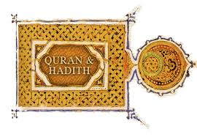
1st verse cont...
O Believers! Do not be forward in the presence of God and His Messenger…
If we act according to our own thinking and ignore or change God’s commandments, we will cause injustice in society.
The verse reminds us that everything we do should be based on a verse of Qur’an or Hadīth, Allah wants to train us to bring peace.

Slide 8
2nd part of the 1st verse:
…وَاتَّقُوا اللَّهَ ۚ إِنَّ اللَّهَ سَمِيعٌ عَلِيمٌ
[49:1] …and be God-conscious; indeed Allah is all-Hearing, all-Knowing
We need to be God-Conscious all the time.
Can you guess what the term in Arabic is for God-Consciousness?

Slide 9
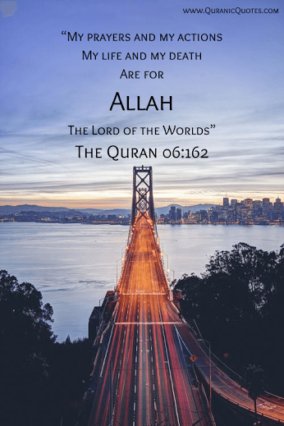
Taqwa
Taqwa is the strength to constantly guard oneself from saying or doing something that will displease God.
The more we listen to God and worship Him, the stronger our Taqwa becomes.
Fasting helps one to gain Taqwa.

Slide 10
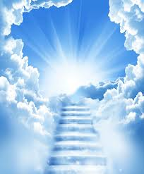
Taqwa brings with it many blessings:
It allows you receive the Qur’an’s guidance
It makes God your teacher
In return, God opens up pathways for your progress
God constantly helps you
And it ensures safety from punishment in the hereafter

Slide 11
When I’m in school, am I God Conscious?
When I wake up am I God conscious?
Where do I need to be God conscious?

