Slide 1
Lesson 7 and 8

Slide 2
Prophet Musa (A)
Learning objectives:
To know that Prophet Musa (A) had Shiahs before he became Prophet.
To learn about the incident that changed Prophet Musa (A)s life.

Slide 3
Surat al-Qasas: Verse 15
Ponder over the verse mentioned above. Why is the term Shiah used in the verse? Even though Prophet Musa (A) had not reached the stage of prophethood, he was still considered a leader amongst the Banu Israil due to his position within the palace. How do you think Prophet
Musa (A)s life changed after this incident?

Slide 4
As the verse states, Prophet Musa (A) entered the city when the people were not expecting him and hence he witnessed how the Banu Israil were really treated. This was an eye opening experience for Prophet Musa (A). He now saw the reality of how his people were actually being treated.

Slide 5
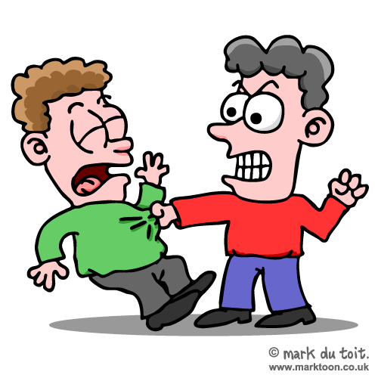
He then noticed that there were two men fighting each other. They were actually trying to kill each other. One of the men was from Banu Israil.
What does the word Shia tell you?
Notes:
The Quran refers to this man as a Shiah of Prophet Musa (A). Shiah in this verse does not signify cultural or racial ties, it is used to express ones following of a person. This man calls out to Prophet Musa (A) for help.

Slide 6
The other man was a Coptic guard, the Quran refers to this man as the enemy of Prophet Musa (A). Prophet Musa (A) intervened trying to stop the two men from fighting and punched the Coptic guard which caused the guard to die on impact.

Slide 7
“This is of Satans doing. Indeed he is clearly a misguiding enemy”
Prophet Musa said this
What does this line tell you about how he felt?

Slide 8
The Shiah of Prophet Musa caused him more problems. Will we be like that when it comes our Imam. How might we change our lifes now so we dint hurt him when he reappears?

Slide 9
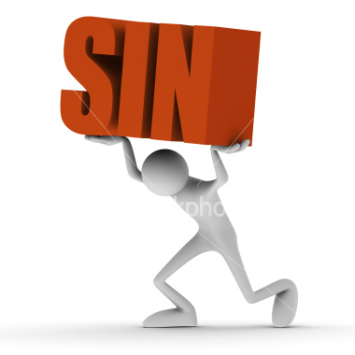
Surat al-Qasas: Verse 16
Why does Prophet Musa as say this?
Did he commit a sin?

Slide 10
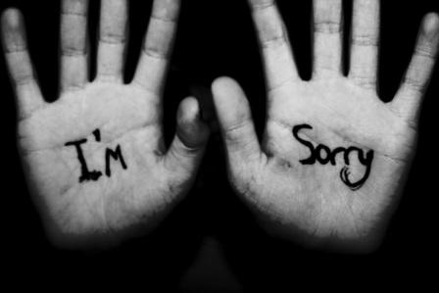
Surat al-Qasas: Verse 17
Why did Musa say this?
What does it show about
his personality?
Would you have said the same thing
in the same situation?

Slide 11
Surat al-Qasas: verse 18-19
Read the sura and tell the person next to you what happened next!

Slide 12
Prophet Musa (A) is now a fugitive, he is in hiding because he knows that Pharaohs guards are looking to arrest him. The next day, the same Shiah gets into another fight and calls Prophet Musa (A) for help. This time Prophet Musa (A) replies to this Shiah and tells him that he is clearly misguided and that he is causing disruption with no benefit to anyone.

Slide 13
Earlier it was mentioned that Pharaoh treated Prophet Musa (A) like his own son and that killing a guard was not a big deal because Prophet Musa (A) was one of the princes. However Prophet Musa (A) is now around the age of 20 and Pharaoh over the years began to realise that he had made a mistake by keeping Prophet Musa (A) in his palace. Pharaoh was now looking for excuses to get rid of Prophet Musa (A) so he started to send him into the front lines of many battles. This incident with the Coptic guard was now the perfect excuse for Pharaoh to get Prophet Musa (A) killed. The news of the death of the guard reached the palace of Pharaoh and Pharaoh held a meeting with his council to decide the fate of Prophet Musa (A)

Slide 14
What can we learn from this change in the plan?

Slide 15
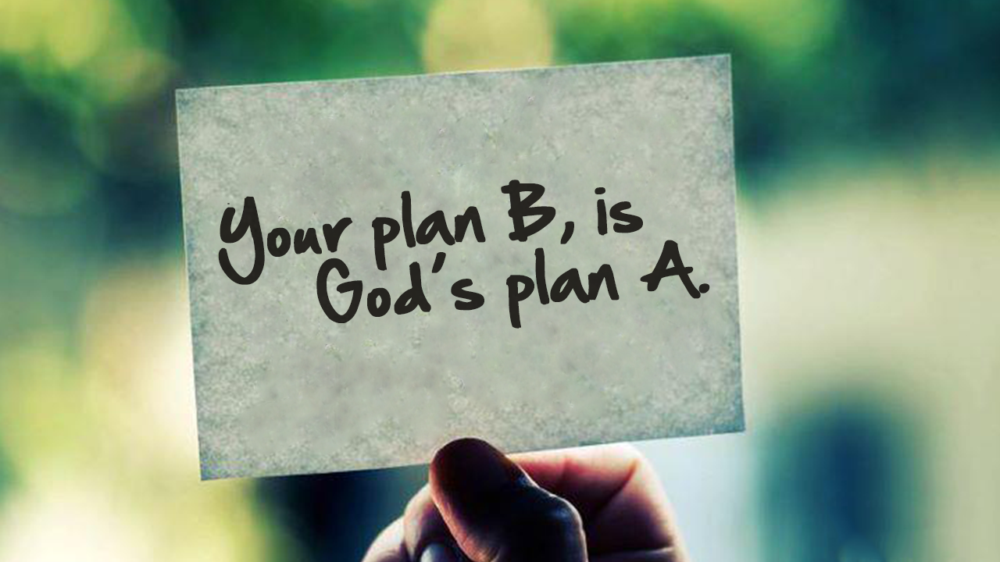
This incident with the Coptic guard changed the ideas and plans of Prophet Musa (A). However, this incident again shows us that we plan and Allah (SWT) plans. This incident was the plan of Allah (SWT). Even though Prophet Musa (A) thought that he made a mistake, through hindsight, one knows that this was all part of Allah (SWT)s greater plan.

