Slide 1
Lesson 4

Slide 2
Allah (SWT)s plan and the birth of Prophet Musa (A)
Learning objectives:
To understand the plan of Allah (SWT) against the evil plan of Pharaoh
To learn how Allah (SWT) protected Prophet Musa (A) once he was born
For students to continue with the memorisation of Surat al-Ala

Slide 3
Pharaoh planned to kill all the baby boys born to the Banu Israil however Allah (SWT) had another plan.
[28:5-6] Read this verse and
Discuss its meaning
What lessons can we learn from this verse

Slide 4
Similarly with us, when we put our trust in Allah (SWT), all the blessing of Allah (SWT) will be bestowed on us. However when we turn our backs to Allah (SWT), we are turning our backs on all the blessings of Allah (SWT).
Allah (SWT) wanted to complete His blessings on the Banu Israil as well as to show oppressors like Pharaoh and Haman that no matter what they plan against Allah (SWT), they will always fail as Allah (SWT) is always with the oppressed.

Slide 5
[20:39] Look up this verse and answer the questions
Who do you think it is talking about?
How does this show God’s plan?

Slide 6
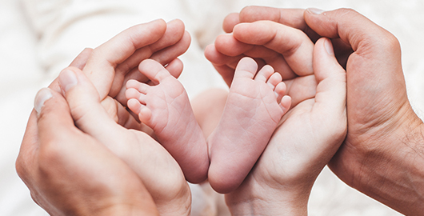
Pharaoh ordered that a Coptic midwife should be placed at every house that was expecting a baby and a Coptic guard should guard those houses, so that when a baby boy is born, he is immediately killed. Of course, this was the case with Prophet Musa (A). There were guards outside his house. The midwife was waiting for him to be born and when he was born, she saw that the baby was a boy!

Slide 7
However, keeping a baby in the house was not easy and Prophet Musa (A) mother was worried that someone will find out and report it to the authorities.
The midwife came out and the guards asked her about the baby. She lied to them by saying that the baby was a girl who died at birth and she had buried her in the garden.
Allah (SWT) placed love for Prophet Musa (A) on anyone who saw him.
So when the midwife saw him, she felt a sense of love for him and decided that she could not get him killed.
The guards believed her and left. Prophet Musa (A) was saved!
Put these into the right order!

Slide 8
[28:7-9] Look up this verse and write down as many different things you can learn from it ….

Slide 9
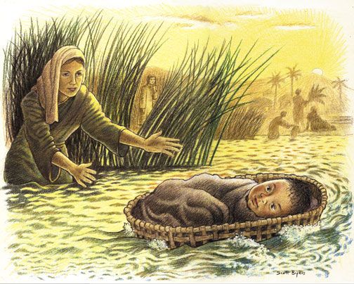
Prophet Musa’s mother must be really special for Allah (swt) to inspire her.
This also shows that Prophet Musa was going to be the saviour the Banu Israel had been waiting for.
The verse highlight that Musa will be returned to her.

Slide 10
Write a diary entry as though you are Prophet Musa’s mother what might you say, how might you be feeling, What fears do you have.

Slide 11
The guards picked up Prophet Musa (A) and immediately wanted to kill him. However, the Pharaohs wife Lady Asiyah stopped them.

Slide 12
What does this teach us?
Come up with 5 lessons learnt from this story.
Create a role play in groups acting out a part of this story. Your role play must include how the characters are feeling and what lessons we learn from this.
You will be judged on
Acting
Your choice of words
How clearly the lessons are portrayed.

