Slide 1
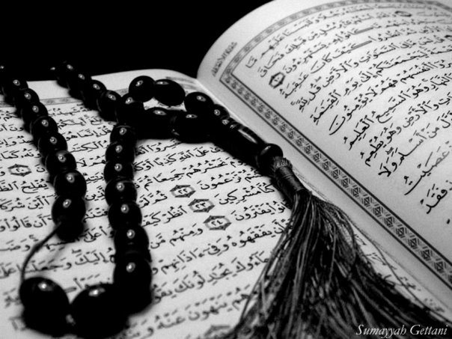
Qur`an Appreciation

Slide 2
Lesson 1 – Importance of the Holy Qur’an
QA
LO’s :
To understand the importance of the Qur’an.
To be able to acknowledge how to show the Qur’an respect.
To know what is recommended to do when reciting the Qur’an.

Slide 3
QA
Match the holy book with the prophet it was revealed to:
ZABUR
P. IBRAHIM (as)
TAWRAH
P. ISA (as)
INJEEL
P. MUSA (as)
SUHUF
P. DAWOOD (as)
Notes:
Choose children to come and join them on the interactive whiteboard or just show with their finger.

Slide 4
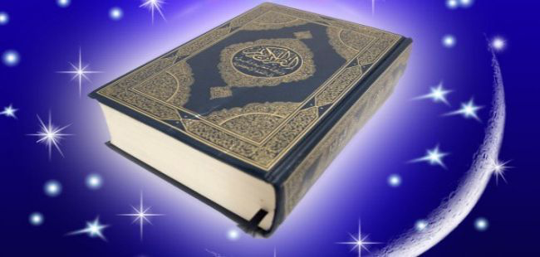
QA
Lesson 1- Importance of the Qur’an
What is this book and why is it so important?
Notes:
Talking partners (discuss with your partner)

Slide 5
So…..What is this book and why is it so important?
QA
The Qur’an is the only holy book that has remained unaltered.
It contains Allah’s exact words that were revealed to Prophet Muhammed (as) through Angel Jibra’eel.
The Holy Qur’an is guidance to all:
…شَهْرُ رَمَضَانَ الَّذِي أُنْزِلَ فِيهِ الْقُرْآنُ هُدًى لِلنَّاسِ وَبَيِّنَاتٍ مِنَ الْهُدَىٰ وَالْفُرْقَانِ
[2:185] The month of Ramadhan is that in which the Quran was revealed, a guidance to men and clear proofs of the guidance and the distinction…
The Prophet (as) appointed special people known as “Scribes” to write down the words of Allah.
Do you know the name of any of the scribes appointed by
the Prophet (as)?

Slide 6
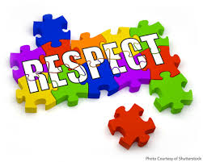
QA
Once you show something respect you are acknowledging its greatness
How can we show respect towards the Holy Qur’an? And do we only show respect if it is the whole book?
Notes:
Talking partners! Children could write down the answers then swap with another pair to discuss things they may have missed out etc..

Slide 7
How can we show respect towards the Holy Qur’an?
QA
Do not leave the Quran open, if you are not reading it.
Do not put any another book above the Qur’an.
It is Haraam (forbidden) to make Najaasaat (impure things like blood and urine) touch the Qur’an.
In the event where the Qur’an becomes Najis, it is Waajib to purify it.
Old and worn out copies of the Qur’an should be disposed in safe places. Eg. recycling, burying them in the earth or casting in rivers.

Slide 8
QA
When the Qur’an is being recited, listen to it and pay attention. There is reward in this.
Imam Ali Zaynul ‘ Aabideen (A) said: Whoever listens to a letter of the book of Allah, the Glorious and Almighty, without even reading it, Allah will write down for him one good deed, forgive a sin, and raise him a degree

Slide 9
QA
Recite the Qur’an regularly;
On the Day of Judgment the Prophet (as) will complain to Allah about some Muslims who abandoned the Qur’an:
وَقَالَ الرَّسُولُ يَا رَبِّ إِنَّ قَوْمِي اتَّخَذُوا هَٰذَا الْقُرْآنَ مَهْجُورًا
[25:30] And the Messenger cried out: O my Lord! surely my people have treated this Quran as a forsaken thing.
Prophet Muhammad (S) said: Brighten your homes with reciting Qur’an; do not turn them into graves. Surely the house in which a lot of recitation takes place enjoys many blessings and the members benefit from it. Such a household shines for the inhabitants of Heaven as stars shine to the inhabitants of the earth.

Slide 10
Do we only show this respect if it is the entire Qur’an?
QA
A part of the Qur’an carries the same respect as the entire Qur’an.
وَإِذَا قُرِئَ الْقُرْآنُ فَاسْتَمِعُوا لَهُ وَأَنْصِتُوا لَعَلَّكُمْ تُرْحَمُونَ
[7:204] And when the Quran is recited, then listen to it and remain silent, that mercy may be shown to you.
Allah uses the word Qur’an for the part that is being recited. Therefore, if you have a binder or a booklet that contains passages from the Qur’an, you must treat it like a Qur’an. So if your Madrasah bag contains the Qur’an, or a part of it (eg. In your manual), take extra care of the bag.

Slide 11
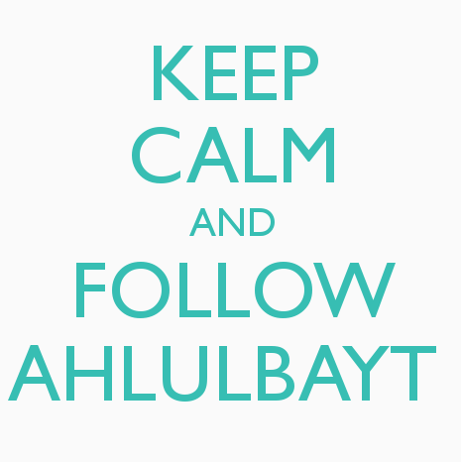
QA
The Qur’an should be followed:
Imam Ja‘far Sadiq (A) said: Lo! One, who learns the Qur’an, teaches it and practices according to it, I will guide and lead him to Paradise.
To know how to follow it, we need to turn to the Holy Prophet (S) and the Ahlul Bayt (A):
Prophet Muhammad (S) has said: I leave behind two weighty things among you: The Book of Allah and my family – the Ahlul Bayt. Indeed these two will never separate until they reach me near the pool of Kawthar.
What do you understand by the above Hadith – Hadith Thaqalayn?

Slide 12
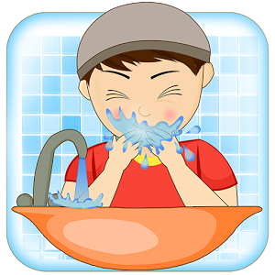
What is recommended to do when reciting the holy Qur’an?
QA
Do Wudhu BEFORE touching the text
الْمُطَهَّرُونَ
[56:79] None shall touch it (the Qur’an) save the purified ones.
Once Imam Ja‘far As-Sadiq (A) asked his son Ismail to read the Qur’an. The latter said that he was not in Wudhoo. The Imam said in that case he could recite it but should not touch the writings of the Qur’an.
What do you understand from the above Qur’anic verse and Hadith?

Slide 13
When you begin reading the Qur’an:
Start by saying:
أعوذ بالله من الشيطان الرجيم
I seek refuge in Allah (SWT), from Shaitan, the accursed
As this is what Allah instructs us to do in the Holy Quran:
فَإِذَا قَرَأْتَ الْقُرْآنَ فَاسْتَعِذْ بِاللَّهِ مِنَ الشَّيْطَانِ الرَّجِيمِ
[16:98] So when you recite the Quran, seek refuge with Allah from the accursed Shaitan,
Then say:
بسم الله الرحمن الرحيم
In the name of Allah (SWT), the Beneficient, the Merciful
What is the difference between الرحمن and الرحيم above?

Slide 14
QA
Recite the Qur’an with Tarteel (in a good voice with rhythm) and slowly:
…وَرَتِّلِ الْقُرْآنَ تَرْتِيلًا
[73:4] …and recite the Quran as it ought to be recited.
لَا تُحَرِّكْ بِهِ لِسَانَكَ لِتَعْجَلَ بِهِ
[75:16] Do not move your tongue with it to make haste with it,
Be Humble when reciting the Qur’an and open your heart and mind to the Qur’an and ponder over what you read.
أَفَلَا يَتَدَبَّرُونَ الْقُرْآنَ أَمْ عَلَىٰ قُلُوبٍ أَقْفَالُهَا
[47:24] Do they not then reflect on the Quran? Nay, on the hearts there are locks.
Finish your recitation with:
صَدَقَ اللهُ العَلِيُّ العَظِيْمُ
Allah, the Sublime, the Great, is truthful in what He has said

Slide 15
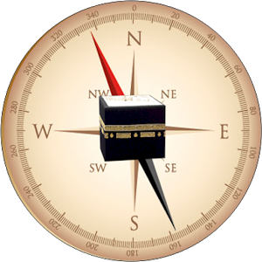
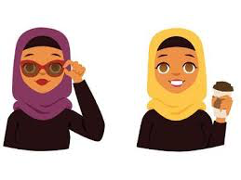
What is recommended to do when reciting the holy Qur’an?
QA
Face Qibla
Look at the words (even if you know them by heart)
Ladies may cover their head
Try not to talk
or eat
Listen carefully
Notes:
NB. Only no.1 is waajib the rest are etiquettes/mustahabaat

Slide 16
PLENARY
QA
So…..What is this book and why is it so important?
How can we show respect towards the Holy Qur’an?
What is recommended to do when reciting the holy Qur’an?
Notes:
Children call out the answers as they recall them - popcorn ideas!

Slide 17
PLENARY
QA
So…..What is this book and why is it so important?
How can we show respect towards the Holy Qur’an?
What is recommended to do when reciting the holy Qur’an?
Notes:
Children call out the answers as they recall them - popcorn ideas!

Slide 18
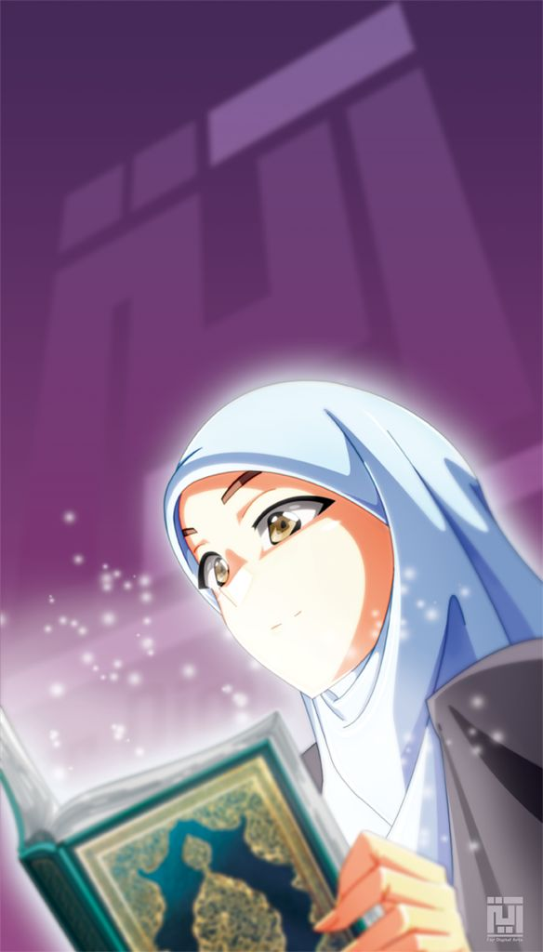
Key Points:
The Qur’an is important because it is the words of Allah which has not been altered.
One of the main ways of showing respect to the Qur’an is to recite it regularly and follow its teachings.
The Qur’an is not an ordinary book, so when we recite it there is an etiquette that should be followed

Slide 19
REFLECTION
QA
How can you implement today’s lesson in your daily life?

