Slide 1
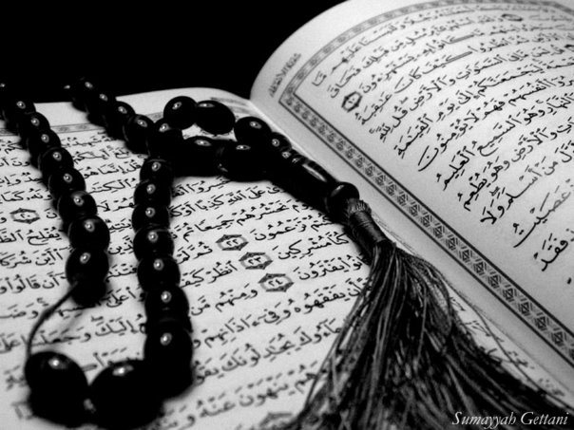
Qur`an Appreciation

Slide 2
QA

Slide 3
QA
Lesson 4
LO:
Studying Verses 11-15
Examining the place of Recreation in Islam
Starter:
Go through Surah Hujaraat (no.49) and write 2 Akhlaaqi traits that you can implement in your life
Notes:
Quick discussion with the class (Please see handouts for Surah text)
NB this is quite a long lesson and may need to be spread over two lessons

Slide 4
Studying Verses 11-15
QA
Vs 11 – 12:
Prophet Yusuf’s (as) brothers were aware that their father didn’t trust them with him.
So they had to convince him to allow them to take Prophet Yusuf (as) out/away from his sight
They did this by saying things like:
Study the handout in pairs and try to find things they said to convince him
Notes:
Have the children study verses 11 - 13 and highlight ways in which the brothers tried to persuade their father – answers on the next page
(please see handouts for activity sheet)

Slide 5
Studying Verses 11-15
QA
Vs 11 – 12:
Referring to Prophet Ya’qub (as) with affection
Asking what reason he had to not trust them
Saying they will look after Prophet Yusuf (as)
Saying that they are strong
Saying they wish Prophet Yusuf (as) well
Asking him to allow Prophet Yusuf (as) to enjoy himself

Slide 6
Studying Verses 11-15
QA
Extended Learning:
The brothers asked Prophet Ya’qub (as) to allow Prophet Yusuf (as) to have fun and enjoy himself
Prophet Ya’qub (as) did not forbid them or Prophet Yusuf (as) from playing or having fun
What does this tell us?
Notes:
Discussion on whether recreation is a waste of time or not

Slide 7
Studying Verses 11-15
QA
Learning Point:
Recreation and relaxation are recommended in Islam as it has a calming and rejuvenating effect, Imam Ali (as) says:
The period when he is in communion with Allah;
The believer's time has three periods:
and the period when he is free to enjoy what is lawful and pleasant.
the period when he manages for his livelihood;
This does not mean the three periods are equal in time, but there should be a part for each of them in one’s life.
Notes:
It is permissible and even recommended within boundaries

Slide 8
Studying Verses 11-15
QA
Vs 13 – 14:
Prophet Ya`qub (as) said he would be sad to separate from Prophet Yusuf and that he is afraid that the wolves may eat him if his brothers are careless or get busy playing
They persuade him saying that they would keep guard of him and fight off any wolves as they are strong
Why was Prophet Ya’qub (as) reluctant?
Notes:
There could be many reasons why P Yaqub (a) was reluctant to let P Yusuf (a) go. Ayatullah Nasir Makarim Shirazi says in his tafsir:
It’s quite natural for P Yaqub (a) to be hesitant over being separated from his beloved P Yusuf (a), from ayah 13 “ It saddens me that you should take him away”; or
He feared from the wolves who freely wandered the dessert and may take advantage of the opportunity of attacking a young child if neglected for even a moment, which is quite possible if kids are busy playing

Slide 9
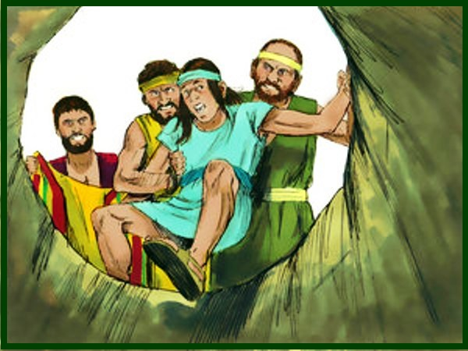
Studying Verses 11-15
QA
Vs 15:
Prophet Ya’qub (as) allows Prophet Yusuf (as) to go with his brothers.
Throughout the night they are busy planning what they will do and also worried that their father should not change his mind.
In the morning they prepare for the outing and take Prophet Yusuf (as) with them.
Prophet Ya’qub (as) reminds them of his concerns once again.

Slide 10
Studying Verses 11-15
QA
Vs 15:
According to narrations their father walks with them to the boundary of the city, embraces Prophet Yusuf (as) and cries a little.
He stands watching them as they left until they were out of sight.
Whilst their father was watching, the brothers were respectful and affectionate with Prophet Yusuf (as).

Slide 11
Studying Verses 11-15
QA
Vs 15:
The moment they were out of sight they began to show their hatred and jealousy.
Prophet Yusuf (as) asked them to be compassionate but they didn’t listen.
As per their plan, the brothers throw him into the well and leave. Prophet Yusuf (as) started to cry and plead to Allah (swt) for help.
At that time Allah (swt) inspires him, through an inner voice, that one day he will... cont...

Slide 12
Studying Verses 11-15
QA
Vs 15 cont:
...have the upper hand over his brothers. He will ask them about this deed of theirs though they will not recognise him.
This gives him hope at a time when he is feeling lonely.
He was sure that G-d was with him and promised him that things would change and one day his brothers would be humbled before him.

Slide 13
Plenary
QA
Group work:
Was Prophet Ya’qub (as) right to allow Prophet Yusuf (as) to go?
Remember he was a prophet and had ‘ilm ul-ghayb – so he probably knew what was going to happen
What can we learn from these verses?
Thinking points:
Trusting everyone
Faith in Allah (swt)
Prejudging/accusations
Notes:
Get children to discuss in groups and then bring together for a class discussion
NB:
Some things that can be learnt
Do not be suspicious or accuse anyone before they have done something, just like Prophet Yaqub (A) did not accuse his sons
Do not share your fears with others, especially those whom you do not trust. It can be used against you, like the brothers did.
Always remember that God is with you when you are on the right. This gives you a lot of strength and comfort, even when you are facing hardships.

