Slide 1
The story of samiri
Class 7- Lesson 5
Quran Appreciation

Slide 2
starter
Sura Taha: verse 88
فَأخْرَجَ لَهُمْ عِجْلًا جَسَدًا لَهُ خُوَارٌ فَقَالُوا هٓذَا إلٓهُکُمْ وَإلٓهُ مُوسَىٰ فَنَسِي
Then he produced for them a calf - a lifeless body which made a mooing sound- and they said, This is your god and the god of Musa, but he forgot.

Slide 3
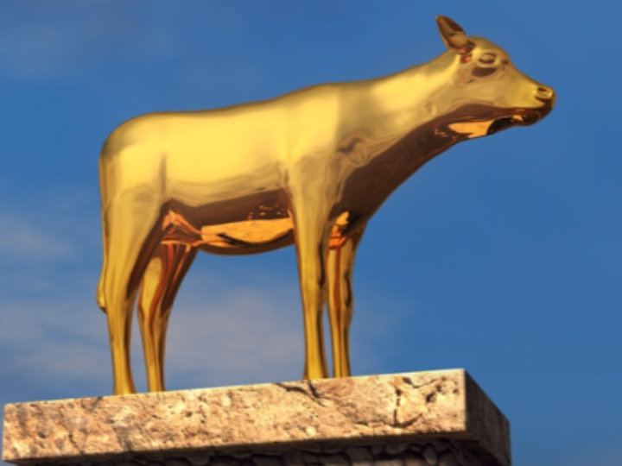
reflections
How could people think that a lifeless body of a calf could be god ?
Why do they say it is the god of Musa too? Had not Nabi Musa told them about his God?
The verse says he forgot. Who forgot? What did he forget?

Slide 4
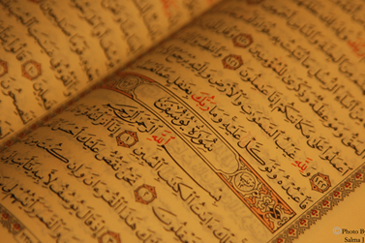
Learning objectives
To explore the reason behind Samiri’s hypocrisy.
To understand the meaning behind verse 88.

Slide 5
What can we understand from these verses?

Slide 6
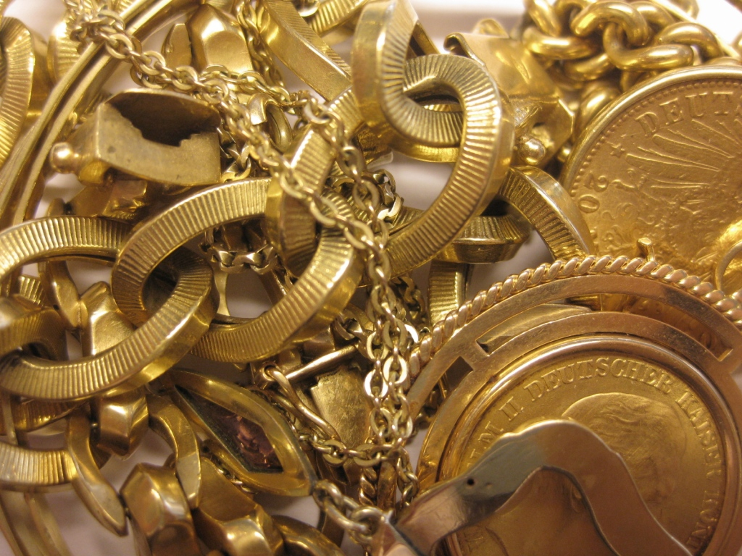
Questions to answer….
What did Samiri do with the gold?
What was the significance of the golden calf?

Slide 7
Relevant verses
7:148- A similar account in a different Sura
And while he was away, the people of Moses took a calf [made] from their ornaments-a body that lowed. Did they not consider that it spoke not unto them, nor guided them to any way? They took it up, and they were wrongdoers.

Slide 8
Relevant verses
59:11, 63:1- Hypocrites are liars
Hast though not seen those who act with hypocrisy, saying to their brothers who disbelieve among the People of the Book, “If you are expelled, surely we shall go forth with you. And we shall never obey anyone against you. And if you are fought, we shall help you.” God bears witness that they are surely liars. [59:11]
When the hypocrites come unto thee, they say, “We bear witness that though art indeed the Messenger of God.’ Yet God knows that thou art indeed His Messenger, and God bears witness that the hypocrites are surely liars. [63:1]

Slide 9
Relevant verses
2:11-12- False claims of the hypocrites
And when it is said unto them, “Do not work corruption upon the earth,” they say, “We are only working righteousness.” Nay it is the who are the workers of corruption, though they are unaware. [2:11-12]

Slide 10
Relevant hadith
“Whoever’s inner [feelings] contradict his outer [expressions] is a hypocrite.” - Holy Prophet (s)
Safina, Vol.2, pg 606
“A hypocrite is cunning, harmful, and doubtful.” - Imam Ali (a)
Ghurarul Hikam
“How ugly is the human being when he has two faces.” - Imam Ali (a)
Ghurarul Hikam

Slide 11
Important lessons
When someone has a skill and understands the mentality of the people, the skill can be used accordingly, both in good or bad ways.
Hypocrisy and cunningness are dangerous for society. It is a misuse of he intellect and must be recognized for what is if people want to be safe from it.
Beliefs have to be strong and based on a firm foundation.
People who change often have the desire to change back to their old ways.
Resistance to going back requires clear thinking, will power and discipline.

Slide 12
Your task…
Discuss the differences between intelligence and cunningness. Get students to say a sentence for each, or divide them into group and each group has to describe an intelligent person or a cunning one.
Let students act out the story - Samiri making a calf, telling people, rumours spread and the people are deceived.
Students can be divided into journalists and some members of the community of Nabi Musa. the journalists interview the people to probe into the story of the golden calf.
Play an adjective word game. Students think of various adjectives to describe Samiri, the golden calf, the people, Nabi Harun (and how he felt at that time).

Slide 13
plenary
Tell the person next to you something you learnt today.

