Slide 1
The Story of Samiri
Class 7- Lesson
Quran Appreciation

Slide 2
Starter
Sura Taha verse 97:
قَالَ فَاذْهَبْ فَإنَّ لَكَ فِي الْحَيَاةِ أنْ تَقُولَ لَا مِسَاسَۖ وَإنَّ لَكَ مَوْعِدًا لَنْ تُخْلَفَهُۖ وَانْظُرْ إلَىٰ إلٓهِكَ الَّذِي ظَلْتَ عَلَيْهِ عَاكِفًاۖ لَنُحَرِّقَنَّهُ ثُمَّ لَنَنْسِفَنَّهُ فِي الْيَمِّ نَسْفًا
He said: Be gone, throughout your life you will say ‘do not touch me’ . And there is another thing waiting for you which you cannot escape. Look at your god which you worshipped for so long, we will burn it then we will scatter it into the sea.

Slide 3
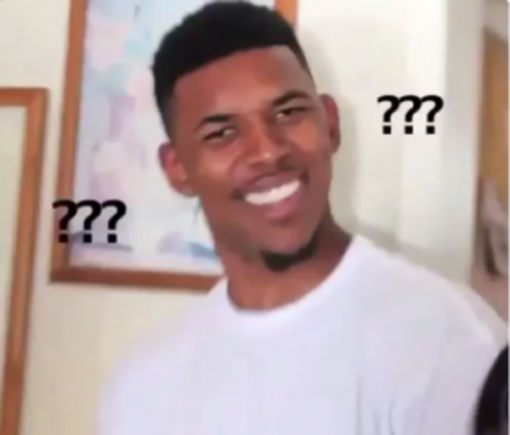
Reflections
Create your own questions for this reflection. What questions do you have about this verse?

Slide 4
What can we understand from these verses?

Slide 5
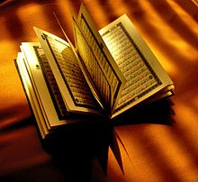
Learning Objectives
To understand the meaning behind verse 97.
To reflect on the tafsir of Sura Taha and the significance of this Sura in the Quran.

Slide 6
Samiri’s plea was not accepted in the court of Nabi Musa (a) and he was sentenced to three punishments:
He would be exiled and would distance himself from the people. It was a self imposed exile. Samiri was afflicted with a mental disease which made him avoid any contact with other people. He told people who came to him to go away and not be close to him. This is how he lived the remainder of his life.
He was warned of the punishment of the Hereafter, something he could not escape.
The golden calf would be burnt and scattered into the sea. It is possible that the calf was made of wood and gold so parts of it would burn. Or perhaps the burning would just melt it and make it lose its shape and it would then be disposed.

Slide 7
Important Lessons
Smartness and an evil nafs are dangerous combinations. they can be used to lead people astray.
Evil must be identified and isolated. A society that lets evil stay within it and does not condemn it is actually letting the evil spread within it.

Slide 8
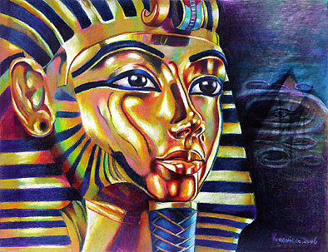
Talk to the people on your table….
Do you think Samiri’s punishments were fair? Why?

Slide 9
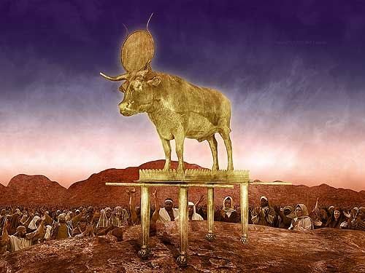
Your Task….
Explore the character of Samiri and his impact on the people, before and after Nabi Musa’s return. Draw a poster, play an adjective game, write a descriptive paragraph . . . anything that will help students see the qualities of evil and the its consequences.

Slide 10
Plenary
Reflect on this topic. What have you learnt? Do you have any unanswered questions you could go and research?

