Slide 1
Lesson 6 and 7

Slide 2
Lesson Objectives
To explore the multiple favours bestowed upon the Bani Israel
How Taurat was revealed

Slide 3
The Blessings and the Clear Signs of Allaah Ta’ala

Slide 4
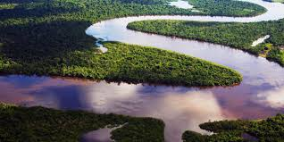
The Flowing of Rivers
The Bani Israeel reached the Sinai Valley which was extremely hot. For a long distance they had not seen any water, or vegetation.
The Bani Israeel begged Hazrat Moosa to do something. Finally Hazrat Moosa turned to the Divine Court.
Through divine revelation, he was commanded to strike his staff on the ground. Hazrat Moosa executed the command.
Immediately twelve streams rushed forth, and each of the twelve tribes of the Bani Israeel had a stream of their own.

Slide 5
Mann and Salwa
Once the water had been attended to the Bani Israeel complained of hunger. Once again Hazrat Moosa supplicated the Divine Sustainer. His prayer was accepted. It happened such that night fell, the next morning the Bani Israeel saw white dew-like drops falling from the sky. When they tasted it, it was very sweet, like a sort of sweet-meat. This was “Mun”. During the day a fierce wind blew, and flights’ of quails descended on to the ground and spread out near them. The Bani Israeel used to roast these quails and eat them. This was “Salwa”.

Slide 6
The Shade of the Clouds
Thereafter the Bani Israeel complained of the severity of the heat, and the lack of shady trees. Once again Hazrat Moosa supplicated Allaah Ta’ala. This prayer was also accepted. Clouds descended from the heavens and shaded the Bani Israeel. Where they went they were shaded by the clouds.

Slide 7
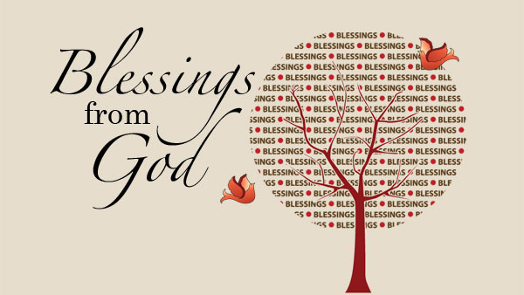
Make a poster showing of your most favourite blessings Allah swt has given you.
Bonus marks: include as many Quran verses as you can.

Slide 8
The Ingratitude of the Bani Israeel.
It is amazing how the Bani Israeel expressed their appreciation for these favours of Allaah Ta’ala! One day they gathered and told Hazrat Moosa:
“Oh Moosa! We are tired of eating the same thing everyday. We don’t need this “Mann” and “Salwa”. Pray to your Allaah to cause things like peas, cucumbers, maize, grain, garlic and onions to grow from the ground, so we may really eat well.”
Hazrat Moosa replied:
“Are you asking to change that which is better for that which is inferior. Go down to the city. Indeed therein is what you ask.” (Baqaraah-61)
Act this scene out and discuss why it was such an issue? Why did Musa get annoyed?

Slide 9
Seclusion at Mount Toor.
Allaah Ta’ala had promised Hazrat Moosa that once the Bani Israeel are freed from slavery, then they will be given a “Shariah” (a code of laws). Through divine instruction Hazrat Moosa went to Mount Toor. There he secluded himself in the worship of the Divine Master.
“And we promised Moosa thirty nights, and we completed it with ten. So he completed the appointed period of his Lord as forty nights.” (A’araaf-142)
Before setting of for his appointed period, he spoke to his brother Hazrat Haroon :
“Be my deputy among my people, rectify them and do not follow the corrupt ones.” (A’araaf-142)

Slide 10
Why was Prophet Musa going to the moutains for 40 days a good way to test the Banu israeel?

Slide 11
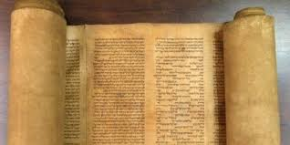
Revelation of the Tauraat.
After this sacred conversation, Hazrat Moosa was given the Tauraat.
“And we wrote everything in the slates for him. (Moosa was commanded): (So hold fast onto it, and command your people to choose the best therein.“ (A’araaf-145)

