Slide 1
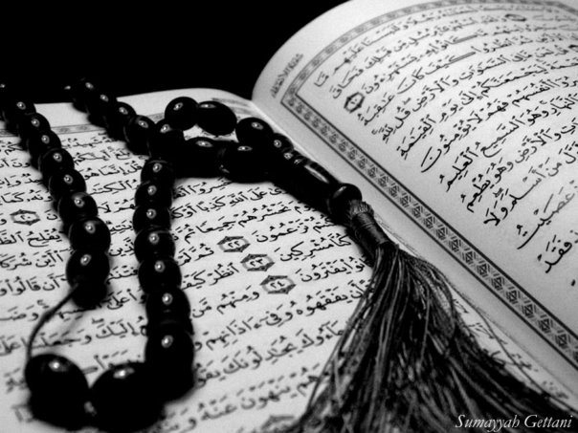
Qur`an Appreciation

Slide 2
QA

Slide 3
Lesson 20
QA
LO:
Studying verses 86 -91
Prophet Yusuf (as) reveals his identity
Starter:
How many suwer in the Holy Qur`an are named after the Prophets (as)?
BONUS:
Can you name them?
Notes:
Answer: 6
Yunus (as)
Hud (as)
Yusuf (as)
Ibrahim (as)
Muhammad (saw)
Nuh (as)

Slide 4
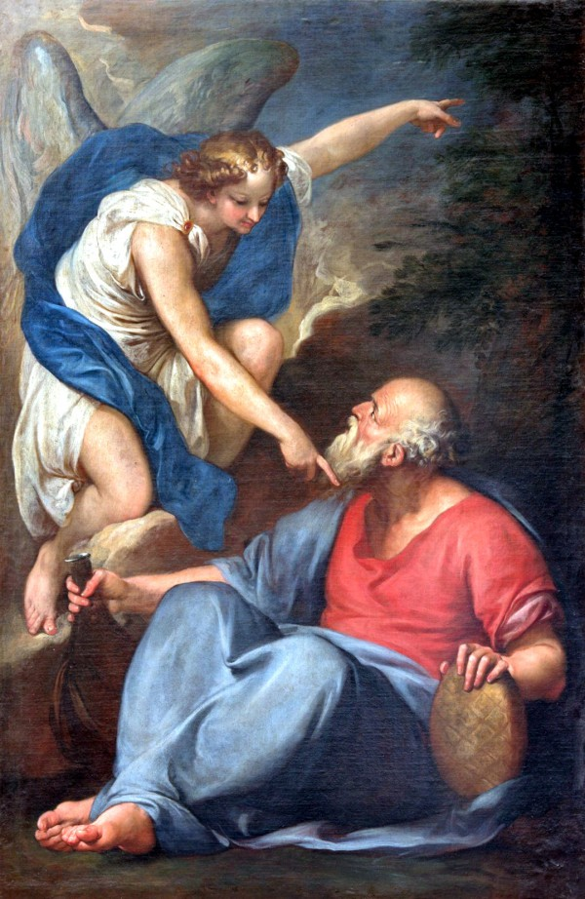
Studying Verses 87 - 91
QA
Vs 87:
Prophet Ya'qub (as) prayed for God to send the Angel of Death to him and enquired from the Angel about the soul of Prophet Yusuf (as)
He then ordered his sons to return to Egypt and enquire about Prophet Yusuf (as) and his brother
Upon seeing their astonishment (as they were convinced of Prophet Yusuf (as)’s demise), he warns them not to despair of God's Mercy as it is not among the characteristics of a believer

Slide 5
Studying Verses 11-15
QA
Extended Learning:
After “shirk” the greatest sin of a believer is that of despairing of Allah (swt)’s Mercy and Benevolence (known as “Yaas”)
Why is that...?
Notes:
According to Ayatullah Dasaghaib Shirazi (author of Greater Sins) it is because this attitude reduces a person to a state of utter hopelessness
He imagines himself to be destined for Hell, and therefore he sees no benefit in doing good and avoiding evil
Consequently he tries to achieve as much worldly pleasure as possible and thus gets further involved in all kinds of sinful acts.

Slide 6
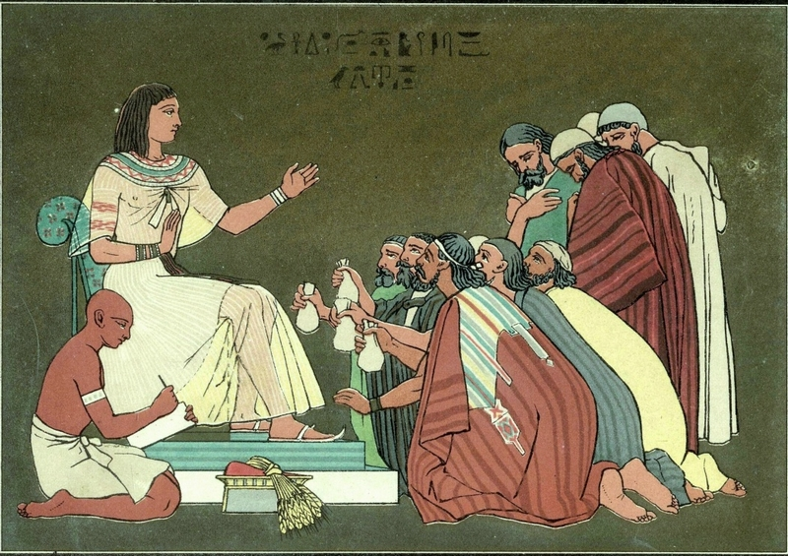
Studying Verses 87 - 91
QA
Vs 88:
Upon returning to Prophet Yusuf (as) the third time, they inform him that their family has really suffered from the drought
And that this time what they have brought in exchange for food is deficient
Their plea was to give the same measure of food as before in the same spirit of generosity as before as Allah (swt) loves those who are charitable

Slide 7
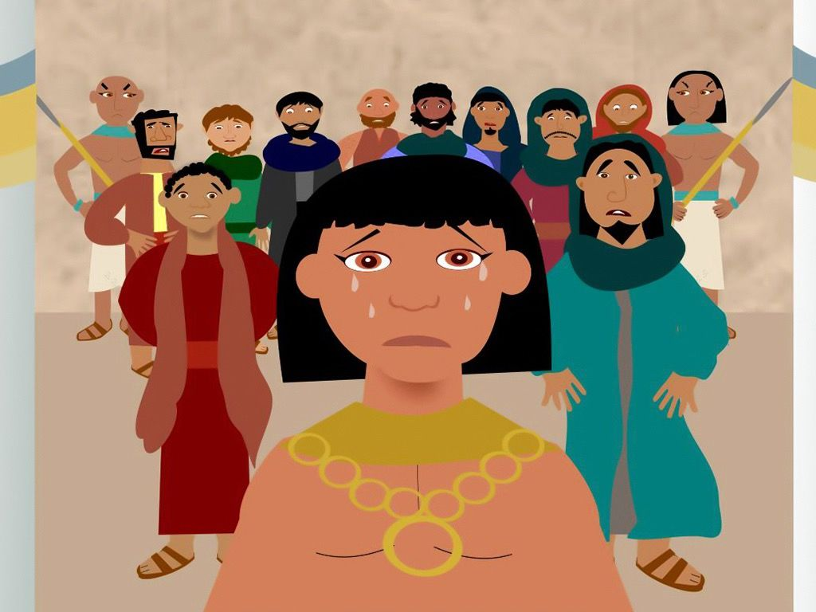
Studying Verses 87 - 91
QA
Vs 88 & 89:
It has also been mentioned that they carried with them a letter from their father addressed to al-'Aziz
In this letter Prophet Ya`qub (as) informs the Aziz of his afflictions and requests him to release Banyameen
When Prophet Yusuf (as) read the letter, he kissed it, placed it on his eyes crying and wailing until his tears wet the shirt he was wearing

Slide 8
Studying Verses 87 - 91
QA
Vs 88 & 89:
Then, he addressed his brothers: "Do you know how your treated Yusuf and his brother when you were ignorant?“
Meaning his humiliation:
His separation from his father at a young age
Putting him into the well
Conspiring to kill him
Selling him as a slave for a paltry price

Slide 9
Studying Verses 87 - 91
QA
Vs 88 & 89:
Then, their isolation of Benyameen until he became despised and rejected among his brothers
A subtle point here is that Prophet Yusuf (as) first informs them of their sins and, then, clarifies for them the path of forgiveness by adding:
“when you were ignorant”.
What can we learn from this?

Slide 10
Studying Verses 87 - 91
QA
Vs 90:
Seeing this reaction their brothers realise that he is Prophet Yusuf (as)
They are still astonished that he is alive and ask him to confirm – which he does
Then, he reminds them that the path that he and Benyameen took - of piety and patience is eternally rewarded by Allah (swt)
Because He never wastes the reward of those who do good – even if the reward may “come late” in this world

Slide 11
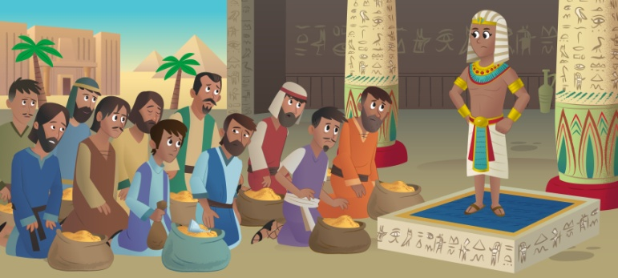
Studying Verses 87 - 91
QA
Vs 91:
The brothers are awe-struck when when they realise Allah (swt)’s Plan
They had tried to rid themselves of Prophet Yusuf (as) and now they had come begging to him
They acknowledged that Allah (swt) had shown him and his brother to be exalted over them in forbearance, knowledge, reasoning and goodness
With remorse, they admit that they were mistaken in choosing the path of action which they followed in their youth

Slide 12
Plenary
QA
Group work:
What three virtues have been emphasised in this stage of Prophet Yusuf (as)’s story and why?
Thinking points:
They plan and Allah (swt)’s Plans…
Prophet Ya`qub (as)’s statements
Notes:
Discussion on the important lessons
Reliance on Allah (swt) combines having
True patience
Trust in His Plans
Hope in His Mercy
Discuss how this was the case in the story of Prophet Yusuf (as) and case studies in our own lives

