Slide 1
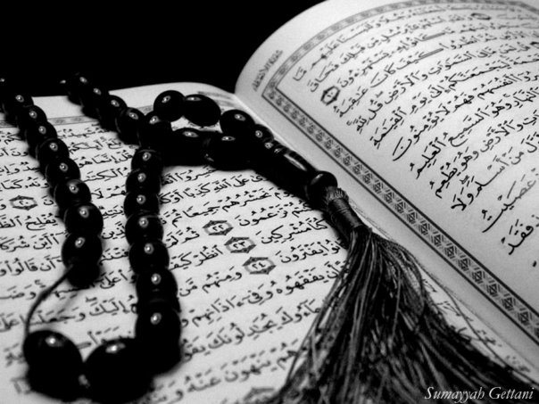
Qur`an Appreciation

Slide 2
QA

Slide 3
Lesson 16
QA
LO:
Studying Verses 58-62
Examining Prophet Yusuf (as)’s attitude towards his brothers
Starter:
How many names of Allah (swt) are mentioned in the Holy Qur`an?
What are they commonly known as?
Notes:
Answers:
The Beautiful Names of Allah (swt) [Asmaa’-ul-Husna] mentioned in the Holy Qur`an are 99

Slide 4
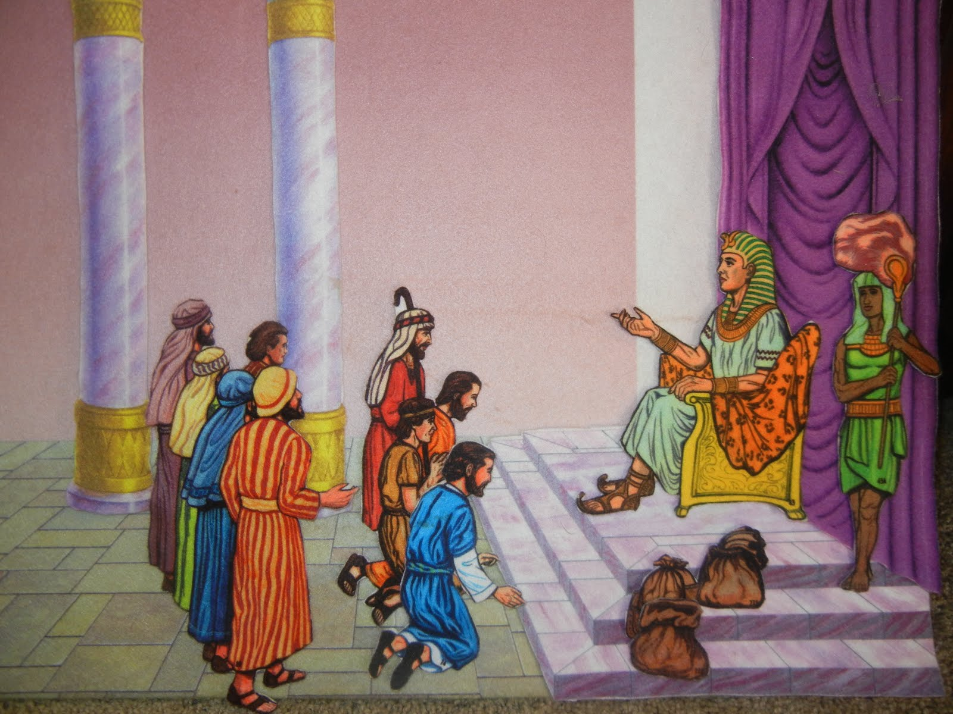
Studying Verses 58 - 62
QA
Vs 58:
After the seven years of fertility, the times of drought arrived
People from all over Egypt came to Prophet Yusuf (as) to buy their food
He treated all people with compassion and equity
He also distributed food to the people on the periphery of Egypt, like Canaan and Palestine, home to his family and forefathers

Slide 5
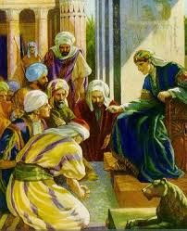
Studying Verses 58 - 62
QA
Vs 58:
The drought had continued to such an extent that Prophet Ya'qub (as) found it necessary to send all his sons to Egypt to buy the family's food from the king
It is reported that upon their arrival, their names and towns were registered with Egyptian officials
When Prophet Yusuf (as) was notified of a caravan from Palestine, he recognized the names of his brothers in the registry and ordered that they be brought before him

Slide 6
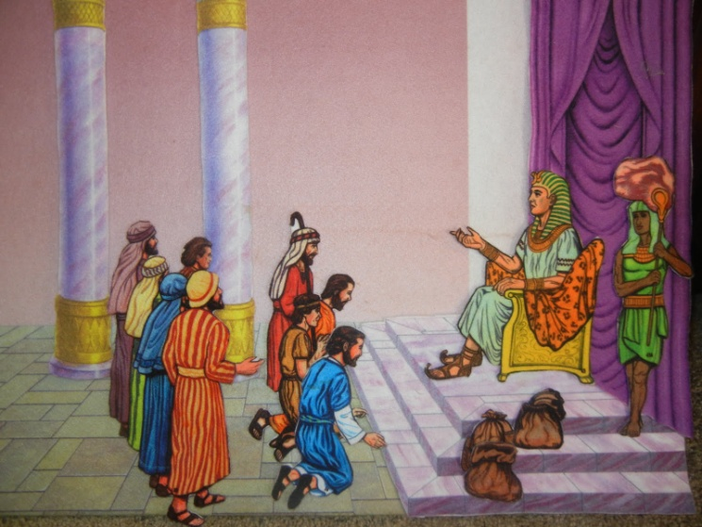
Studying Verses 58 - 62
QA
Vs 58-59:
Nearly forty years had passed from the time when his brothers placed him in the well until this time and it is apparent that his brothers did not recognize him
Each person who purchased food was given food for each camel to carry
He then had a conversation with his brothers – without revealing his true identity
He asked them about another brother of theirs (Benyameen) whom they said was with their elderly father

Slide 7
Studying Verses 58 - 62
QA
Vs 60-62:
He told them to bring him the next time they come to purchase food – reminding them how generous he had been towards them as a host as well as trading with them so fairly
He ensured his brothers would return with Benyameen in two ways:
Giving them an ultimatum (bring him or no trade)
Asking his servants to secretly return their good they had brought to exchange for food
Why did he not reveal his identity?
Notes:
Discussion Point:
Why did he not reveal his identity?
Perhaps for a few reasons:
Some commentators say that Allah did not allow Yusuf to do this because this separation was a trial for Ya‘qub and he was compelled to successfully undergo this period as was ordained by Allah.
Therefore before the end of this test, Yusuf was not allowed to introduce himself.
Another reason could be that if he had immediately introduced himself to his brothers, undesirable reactions might have resulted, among them was that they might have become so fearful that they would not have come back at all presuming that he would take revenge upon them for the past
This way he could also ensure that if he commanded them to do something (i.e. Bring their brother with them) they would feel obliged to do so out of fear of incurring a king’s wrath

Slide 8
Plenary
QA
Group work:
Why do you think Prophet Yusuf (as) wanted to see his brother Benyameen?
What traits did he display towards his brothers and why is that important?
Thinking points:
How are they related?
How should one behave in a position
of power and authority?
Notes:
Discussion:
Benyameen and Prophet Yusuf (as) were the only full brothers – they both had he same father and mother
Benyameen reminded Prophet Yusuf (as) of his father Prophet Ya’qub (as) whom he missed dearly
He saw this as an opportunity to be reunited with his father through his brother after so many years
Prophet Yusuf (as) treated his brothers with kindness and generosity even though they had abandoned him in the well
He had an opportunity to turn them away empty handed but didn’t do so – moreover he returned their goods which they had brought with them to exchange for the grain they purchased from Prophet Yusuf (as)
This had the further effect of making their hearts inclined towards him and thus try harder to do as he requested

