Slide 1
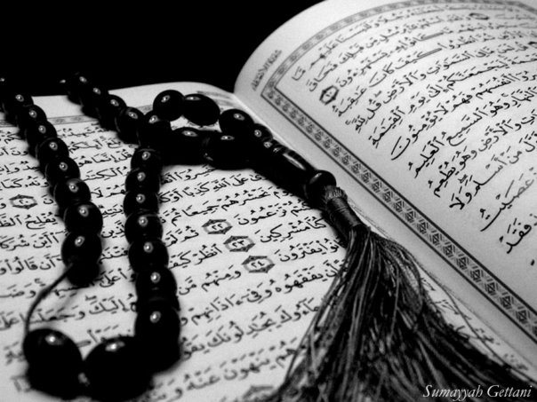
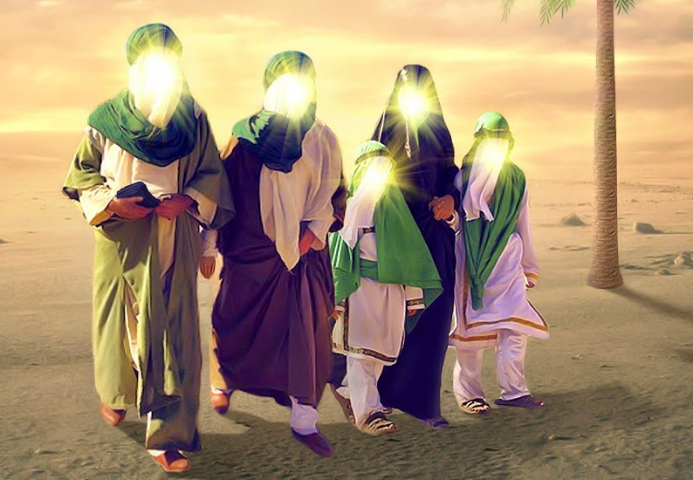
The Ahlul Bayt (as)
in the Holy Qur`an
QA

Slide 2
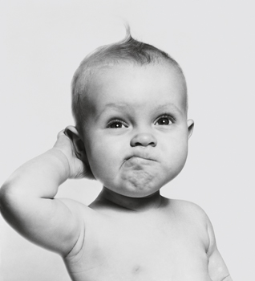
QA
Lesson 14
LO:
To understand the concept of wilayah in Sura Nabaa
To discuss the virtues of studying Surah Nabaa
Starter:
How many surahs start with ‘inna’?
Bonus: Can you name these surahs?
Notes:
Answer: 4 – Surah Fathia, Surah Nuh, Surah Kausar, Surah Qadr

Slide 3
Recap: The Great News
“O what do they ask (one another)?”
“Of the Great News”.
Commentators have different ideas as to what naba’-in-`ażim (great news) means:
‘the revelation of the Holy Qur’an’
‘The whole Islamic Principles’
‘the Day of Resurrection’
‘wilayah and imamat’
Notes:
Today’s focus will be on imamat and wilayah

Slide 4
Naba’‑in‑‘Ażim
Last lesson we focused on how the ‘Great News’ (naba’‑in‑‘ażim) refers to the Day of Resurrection
There are many narrations, cited by the ‘Ahlul Bayt’ (as), that say the phrase ‘Great News’ (naba’‑in‑‘ażim) refers to Hazrat Ali’s (as) Imamate

Slide 5
Imam Ali (A) = The Great News
On the day of the Battle of Siffin, a man from the troops of Damascus, entered the battlefield while reciting Surah Nabaa.
Then Ali (as), himself, faced him and questioned him: “Do you know what naba’‑in‑‘ażim (the Great News), in which they differ, is?”
The man replied: “No, I do not know”.
Imam Ali (as) said:
“I am, by Allah, the very naba’‑in‑‘ażim (the Great News) that you differ in and you quarrel against my vicegerency. You turned away from my vicegerency after you had pledged allegiance to it, and only on Doomsday will you really comprehend, once more, what you had understood about it before”

Slide 6
Different Interpretations
. A narration from Imam Sadiq says: “‘The Great News’ is the same as Vicegerency (Imamate)”.
As we can see there are many different interpretations of the verse with the ‘Great News’
The Qur’an has various meanings; that is, a verse may have several meanings, in different dimensions – What is the name of the type of verse in the Quran which has a metaphorical or ambiguous meaning?
Notes:
Answer: Mutashabih Verse

Slide 7
Hadith of the Golden Chain
Imam al-Ridha (A) has said:
"I heard from my father Musa ibn Jafar who said he heard from his father Jafar ibn Muhammad who said he heard from his father Muhammad ibn Ali who said he heard from Ali ibn Husayn who said he heard from his father Husyan ibn Ali who said he heard from his father, the commander of the faithful, Ali ibn Abi Talib who said he heard from Allah’s apostle, peace be upon him and his household, who said he heard from Jibraeel who said he heard that Allah said: "There is no god but Allah is my fortress whoever enters my fortress shall be safe from my punishment…There are few conditions and I am one of its conditions"
How does this hadith demonstrate the importance of wilayah?

Slide 8
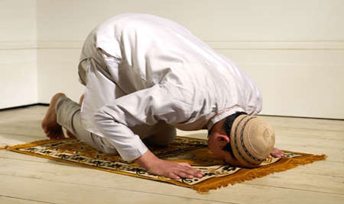
Virtues of Studying Surah Nabaa
It has been narrated by the Holy Prophet (S.A.W):
“He who studies Surah Nabaa will be satiated, by Allah, with a cold drink in Heaven.”
“He who studies it (Surah Nabaa) and learns it by heart, on the Day of Judgement, his reckoning will be concluded (so quickly) equal to the length of time it take to say a single prayer.”
Quenched

Slide 9
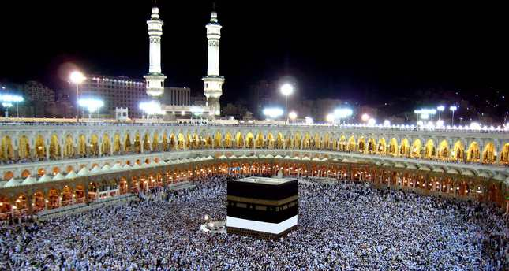
Virtues of Reciting Surah Nabaa
Imam Jafar Sadiq (A) has also said,
“He who continues studying Surah Nabaa everyday will meet the Holy Shrine at Mecca (Kaaba) before the year ends.”
Does that mean I study the Surah for a year I will be guaranteed to go to Mecca that year?

Slide 10
QA
Plenary
Over the past two lessons we have been looking at the first few ayats of Surah Nabaa and talked about resurrection and wilayah Use the spider diagram you have been given to summarise everything you have learnt on the surah. You may use both pictures and /or words to describe your ideas.

