Slide 1
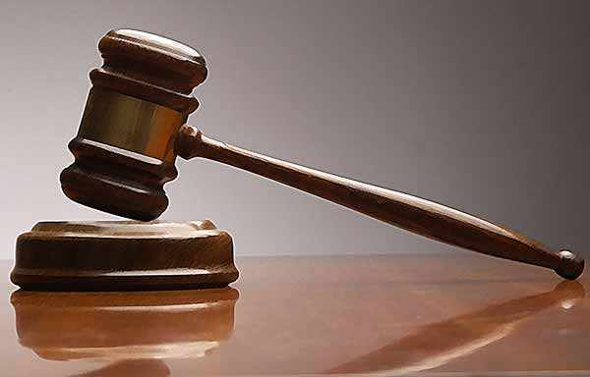
The court of Firaun

Slide 2
Hazrat Moosa and Hazrat Haroon decide to go to Firaun and convey the message of Allaah Ta’ala to him.
With this object in mind the two brothers fearlessly entered Firaun’s court. Upon reaching the throne they presented their message:
And Moosa said:
“Oh Firaun! Verily, I am the apostle of the Sustainer of the worlds.” (A’araaf-104)
“It is incumbent upon me that I do not say anything against Allaah Ta’ala save the truth. Surely I have brought evidence from your Sustainer. So send the Children of Israel with Me.“ (A’araaf-105)
What does sustainer mean?

Slide 3
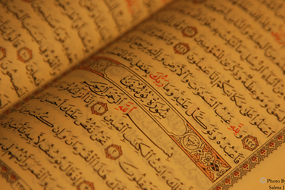
Read (Shu’araah-19) to find out what Firaun said.

Slide 4
Thereupon Hazrat Moosa (A.S) said:
“When I did it, it was an error.” (Shu’araah-20)
“Terrified, I fled from you, and my Allaah endowed me with wisdom, and included me among the Sent Ones.” (Shu’araah-21)
“And those favours which you gloat of, was that you enslaved the Children of Israel.” (Shu’araah-22)
What do you think about
Prophet Musa’s words?

Slide 5
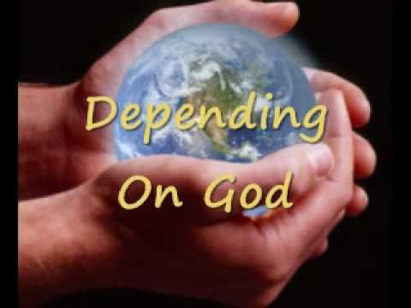
Thereupon Firaun enquired:
“What is meant by? Rabb-ul-Aalameen’ {the Sustainer of the worlds}?” (Shu’araah-23)
Hazrat Moosa(A.S) replied:
“Rabb-ul-Aalameen’, is that Being from whose sustenance not even you and your ancestors are independent.
How dependent are we on Allah swt?

Slide 6
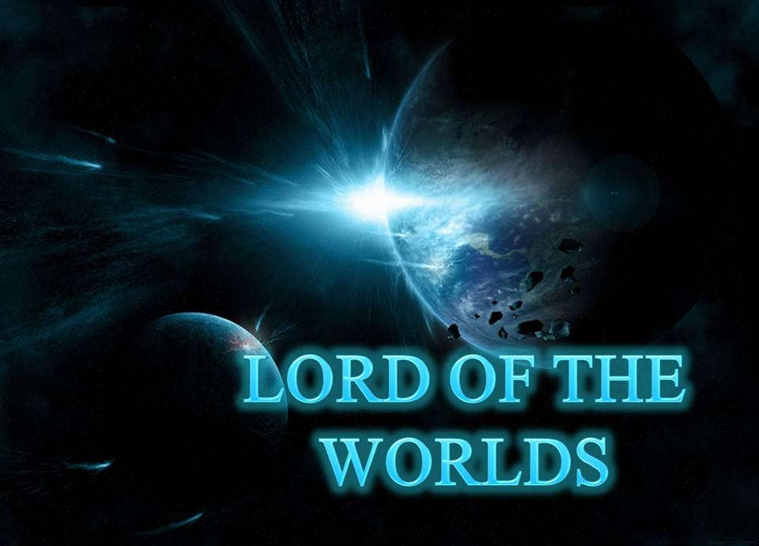
Once again Hazrat Musa reminded Firaun:
“That path which you have chosen is not the straight path. ’Rabb-ul-Aalameen’ is the only Being who is worthy of worship. Any one who claims to be the Sustainer is an outright polytheist. Oh Firown ! Abstain from this because that Being who is ’Rabb-ul-Aalameen’ has revealed to us that whosoever opposes the Truth, refutes it and turns away from it, will be deserving of the wrath of the Divine Master.”
“Indeed it has been revealed to us that the chastisement will be for him who belied and turned away.” (Taahaa-48)

Slide 7
Firown was dumbstruck. As he could not argue the matter any further, he said:
“I think that this person who calls himself your prophet is mad.”
When Hazrat Musa realised that Firown was out-witted, he decided to explain the Providence of Allaah Ta’ala more impressively.
He said:
“That Being in whose hands lies the East and the West, and all that is therein, He is Who I call ‘Rabb-ul-Aalameen’. With a little intelligence you will easily realise this.”
Act this scene out… then hot seat each other take it in turns to be Prophet Musa and Firaun...
Think about how you feel?

Slide 8
Firown again asked:
“Who is your Sustainer, Oh Moosa ? “ (Taahaa -49)
Hazrat Moosa replied:
“Our Sustainer is He who has created everything with its form, then he guided it.” (Taahaa-50)
Then Firown enquired:
“Then what happened to the former generations.” (Taahaa-51)

Slide 9
Hazrat Moosa replied:
“That knowledge is (recorded) by my Sustainer in the book. My Allaah did not make a mistake nor did He forget.” (Taahaa-52)
“He is that Being who has spread the earth for you and opened there-in pathways (roads) for you, and sent from the Heavens water. And thereby we have brought forth various kinds of vegetation.” (Taahaa-53)
“Eat and let your animals graze. Indeed there-in are signs for the men of prudence.” (Taahaa-54)
“From it (this earth) we have created you, and into it will we return you, and therefrom we shall bring you forth once again.” (Taahaa-55)
How would you describe God to someone?

