Slide 1
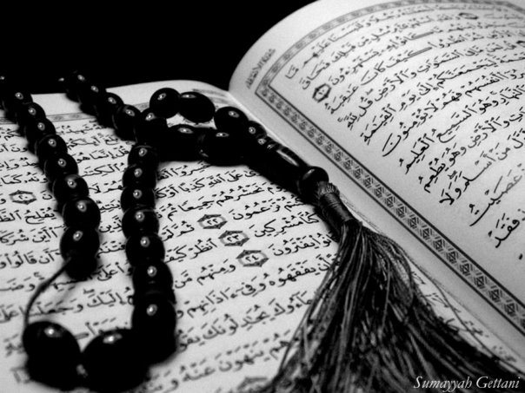
LESSON 5
A Journey into the Desert
Qur`an Appreciation

Slide 2
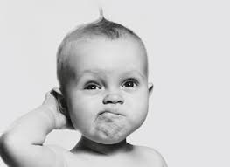
What is Dua and when and how do we recite a Dua?

Slide 3
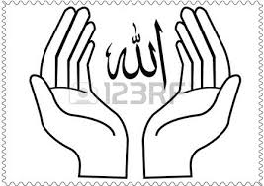
Learning Objectives:
To recognise the power of dua and the true essence of Tawakkul (reliance) upon Allah (swt)
To identify the ritual of Sa’ee during Hajj as an emulation of the act of Lady Hajra

Slide 4
Prophet Ibrahim had been married to Lady Sarah, a woman of great honour, for several years.
Despite their longing for a child, Allah (swt) in His wisdom did not provide them with one.
Prophet Ibrahim took her advice and soon he and Lady Hajra were blessed with a baby boy they named Ismail – who later became a prophet too.
When Lady Sarah realised that she could no longer hope for a child due to her advanced age, she encouraged Prophet Ibrahim to remarry another woman of great honour – Lady Hajra.

Slide 5
The name, Ismail itself comes from the root word 'Samia' meaning 'to hear', because Allah heard and answered the invocation of Prophet Ibrahim as mentioned in the Holy Quran:
DUA
“My Lord! Grant me a child from amongst the righteous. So We gave him good tidings of a forbearing boy.” - Surah as-Saffat 37:100-101

Slide 6
It has been reported that the Holy Prophet Muhammad (saw) once said,
“Shall I introduce to you a weapon which will protect you both from the evils of enemies and increase your sustenance?
Yes, O Messenger of Allah.
Call your Lord day and night, for “Dua” is the weapon of a believer.”
DUA
Thus, Prophet Ibrahim’s dua was answered.

Slide 7
Prophet Ibrahim was then commanded by Allah to take Lady Hajra and their son to a far off land known as ‘Bakkah’ – a desert with no evidence of people, water or shelter.
When they arrived there, Prophet Ibrahim settled his small family and gave them essentials of food and water.

Slide 8
As he began to leave, Lady Hajra asked why he is leaving them in a land with nothing to offer.
Prophet Ibrahim had nothing to respond to that. Lady Hajra then asked…

Slide 9
“Did Allah (swt) order you to do this?”
“Yes”
“Then we will not be lost.”

Slide 10
As Prophet Ibrahim walked away, he turned and looked at his wife and son, and then prayed,
“Our Lord! I have settled some of my offspring in a barren valley by Your Sacred House so that they would perform the Prayer. Oh Lord, make the hearts of people yearn towards them and provide them with fruits for which they would give thanks.” – Surah Ibrahim 14:37

Slide 11
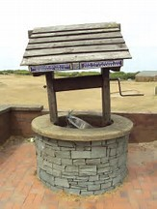
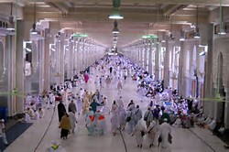
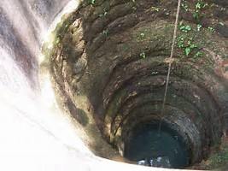
Video of Saf Marwa Zam Zam story
https://youtu.be/Gj18whSKF7E
Notes:
Link to 3 minute youtube video of bibi Hajras story

Slide 12
This action of Lady Hajra is also emulated in the ritual of Sa’ee during Hajj when people walk between the two hills of Safa and Marwa seven times in memory of this miracle that saved the lives of Lady Hajra and Prophet Ismail.

Slide 13
When Prophet Ibrahim returned he was amazed to see the valley.
The water had made the place very fertile and a civilisation had begun with caravans and animals visiting there as a resting place between their journeys and some even making their home in the now prosperous land of Bakkah.
The migration of Lady Hajra and Prophet Ismail to Bakkah, and the miracle of the well of Zamzam paved the way to invite people towards the Kaaba – the House of Allah.

Slide 14
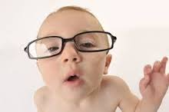
PLENARY
Why do you think Allah (swt) makes us experience trials and difficulties?
Can you recall examples in history when a person trusted and followed a commandment by Allah (swt) even though it had no apparent logic at that time.
Notes:
Ask chn to work in pairs to think of events. .
1.[Prophet Nuh – the ark, Prophet Musa – the basket, Lady Maryam – fast from speech…]
2. [Test of faith, bring one closer to Allah (swt), avenue to seek forgiveness…]

